Slide 1
Unit 3 Chapters 10 & 11
The Industrial Revolution Begins

Slide 2
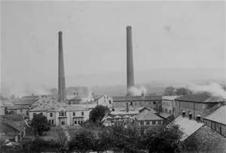
Section 1: Dawn of the Industrial Age
The Industrial Revolution was (2) human and animal power being replaced by new power sources. Economies began to shift from farming to manufacturing (creating products in factories).

Slide 3
Where did it begin?
2. The Industrial Revolution began in Great Britain.
Great Britain had (3) an ample supply of labor and natural resources.

Slide 4
Factors that Contributed to the IR
4. The Agricultural Revolution --- the creation of new equipment (John Deere), the introduction of new crops (potato/corn), and other factors meant that more people could be fed for less.
This, along with new medicine and advances in science, helped spark a population boom.

Slide 5
Factors
The growth in population provided labor (workers) for the new factories.
When Parliament passed (5.) enclosure movement laws (laws that allowed large landowners to fence off land shared by peasants), the peasants were forced to move to the city and work in the factories.
The (6) enclosure movement is an example of a “pull” factor for migration to industrial cities

Slide 6
Factors that contributed to the start of the Industrial Revolution
7a. The increasing development of new technology and machines
7b. A continuously growing population throughout all of Europe
7c. The Agricultural Revolution and the ongoing improvement in farming methods

Slide 7
Cottage Industries
10. A cottage industry was a two step process that people did in their rural homes, also called cottages.
Step 1 – Spinners made cotton thread from raw cotton
Step 2 – Weavers turned the thread into cloth on looms.
These cottage industries were replaced by James Hargreave’s spinning jenny and Edumund Cartwright’s water-powered loom.

Slide 8
Cottage Industries
Why were Cottage Industries being replaced in Great Britain at the end of the 18th Century?
8. New technology could produce fabrics more efficiently than the Cottage Industries

Slide 9
Spinning & Weaving Machinery
The invention of spinning and weaving machinery increased the number of workers in the textile industry in Europe because
9. The demand for goods increased as goods became cheaper to produce.

Slide 10
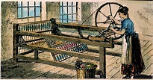
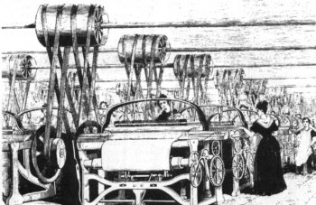
The spinning jenny and water-powered loom

Slide 11
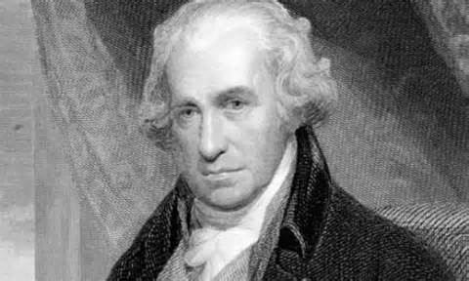
The First Factories
The first factories were built (10) along rivers as they provided a constant and cheap source of energy. However, when James Watt improved the steam engine, factories could use coal for power instead of water.

Slide 12
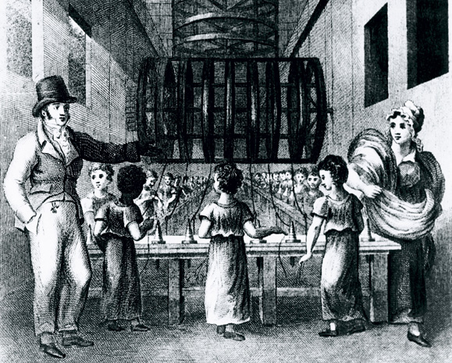
Early Factory Workers
13. Early factory workers came from rural areas where they had been kicked off of the land. Many women and children also worked in the factories.

Slide 13
Working Conditions
Working conditions in factories were much worse than they had been on farms:
11a. People were forced to work long hours
11b. sick and/or injured workers were fired if unable to work
11c. children were forced to work in factories for long hours and little pay

Slide 14
The Steam Locomotive
The Steam Locomotive transformed the British economy by creating a cycle:
Building railroads provided many new jobs
Less expensive transportation made goods cost less, meaning a bigger market.
More sales meant more need for factories
More factories meant more profit for factory owners
More profits meant they could build more railroads and more factories
IT GREW THEIR ECONOMY TREMENDOUSLY!
12. It helped the economy by increasing demand by providing cheaper transportation of goods

Slide 15
Great Britain’s Secret
Great Britain enjoyed the fact that they were the leaders of the I.R. and 13. passed laws to prevent the exporting of industrial inventions in hopes to keep the I.R. from spreading to other nations.

Slide 16
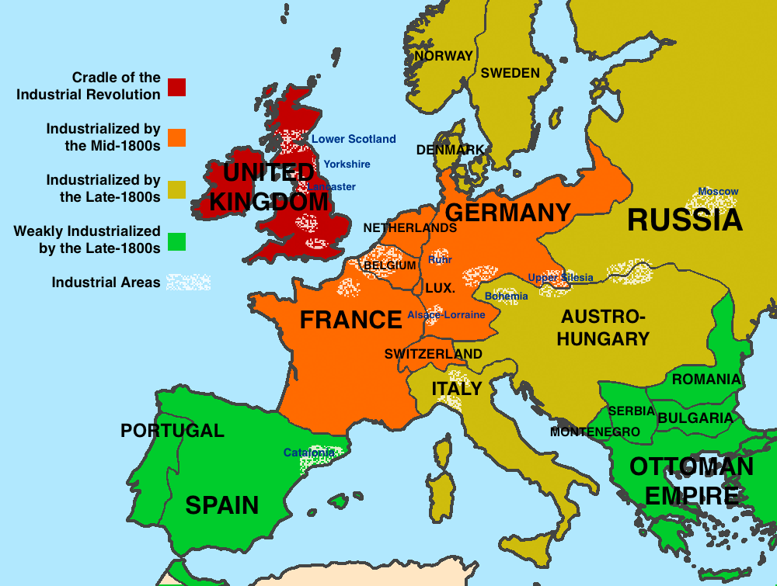

Slide 17
5 Factors for Industrialization
The 5 factors that any nations that is industrializing must have are:
14A. Land (natural resources)
14B. Labor (workers)
14C. Capital (money and equipment)
14D. Technology
14E. Stable Government (NO REVOLUTIONS!)

Slide 18
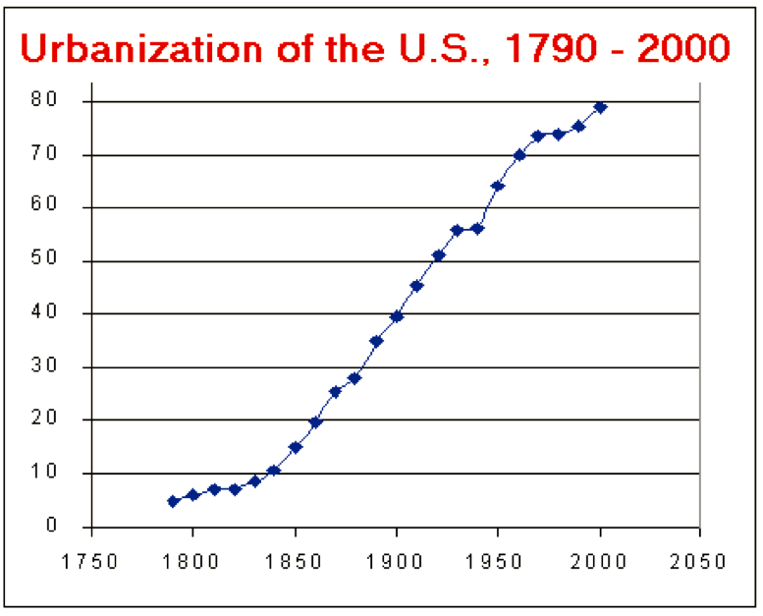
Urbanization
As jobs increasingly moved to the factories, people increasingly moved to the cities. People moving from rural areas to urban areas is called urbanization.
15. It caused overcrowding issues in cities as people continued to move there

Slide 19
Emerging Social Classes
Two new social classes emerged during the Industrial Revolution, the industrial working class (proletariat) and the industrial middle class (different than bourgeoisie).

Slide 20
Industrial Capitalism
Industrial Capitalism was a shift from economies based on trade to economies based on manufacturing and industry. The goal of any kind of capitalism is to make a profit.
The (16) middle class benefited most from the industrialization of the 19th Century.

Slide 21
Factory Life
Life was bad for the factory workers.
Exhausted workers were often injured
Sick or injured workers were often fired
Women were hired, which caused neglect of “normal” home duties
Children/orphans were often hired due to their small size
17. Their small size was an advantage in many situations.

Slide 22
Positive Impacts of Industrialization
18a. new, practical inventions were being created
18b. a larger middle class developed
18c. the population boom meant a greater demand for goods

Slide 23
What impact and/or reaction is the artist attempting to trigger?

Slide 24
Political Cartoon Analysis
To what political event or idea is the cartoon referring?
What key person(s) are targeted in the cartoon?
How has the artist depicted these people? Are they distorted in any way? Does
the artist’s portrayal of characters cast them in a negative or positive light?
What is the message of the cartoon?
What impact and/or reaction is the artist attempting to trigger?

Slide 25
Rise of Socialism
Socialism is a type of economic system where society (government) owns the means of productions (factories, land, etc…)
Many workers and others believed that since the workers provided the labor, they should own the factories.
19. Society collectively should own all means of production instead of individuals

Slide 26
Capitalism v. Socialism
Capitalism: an economic and political system in which a country's trade and industry are controlled by private owners for profit, rather than by the state.
The difference between capitalism and socialism is (20) Private versus public ownership of industry

Slide 27
Pioneers and Entrepreneurs
Henry Bessemer – patented a new process for making high-quality steel called the Bessemer Process.
(22) It purified iron in such a way that created a stronger, lighter, durable steel
(21) Thomas Edison – created the incandescent light-bulb
Wright brothers – responsible for the first flight in Kitty Hawk, North Carolina
Henry Ford – (yes, the founder of Ford) he is responsible for the assembly line

Slide 28
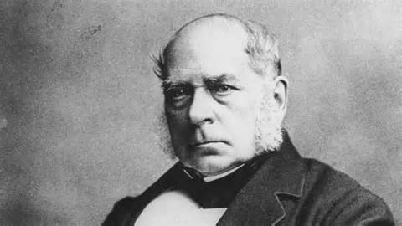
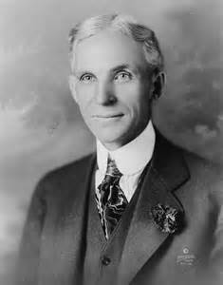
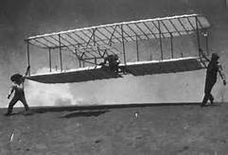
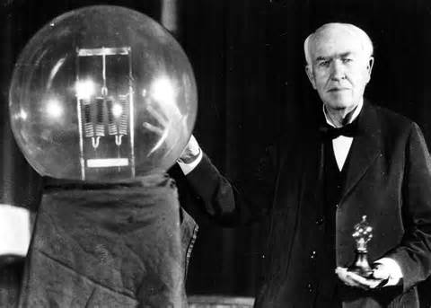

Slide 29
What about the other countries?
Other countries that did not industrialize, like Spain, Portugal, and Russia, provided the industrial nations with food and raw materials.
They did not industrialize because these nations were less advanced politically and technologically.
(23) Industrial nations turned raw material from non-industrial nations into manufactured goods.

Slide 30
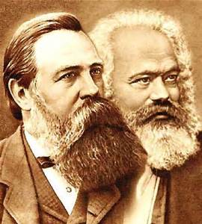
The Communist Manifesto
31. Karl Marx (with the help of Frederick Ingles) wrote The Communist Manifesto.
24. The main idea of the Communist Manifesto is that the proletariat must unite to overthrow the bourgeoisie

Slide 31
Unions
35. A trade union, or labor union, is when workers organize to demand certain rights (fair wages, shorter working hours, safer conditions, etc…)
Labor unions developed during the Industrial Revolution to (25) improve working conditions

Slide 32
Feminism
As women gained more independence, feminism began to grow. Feminism is the movement for women’s rights. It’s main goal was (26) social equality in America based on the idea of Natural Rights. It began as a push for the right of women to hold property.
However, it also included women’s suffrage. Suffrage is the right to vote.

Slide 33
Public Education
Public education began to grow for three reasons:
27a. Factories needed better trained workers to work new technology
27b. The rise of democracy demanded a more literate voting population
27c. Countries were instilling a since of nationalism in their young population

