Slide 1
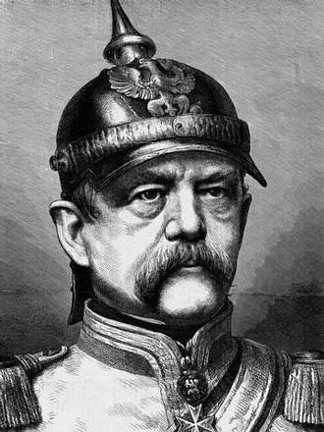
BUILDING A GERMAN NATION
In the early 1800s, German speaking people lived in many small states, as well as in Prussia (Germany to be) and Austria. German people wanted unification.
This demand continued into the 1860s when Otto von Bismarck was named chancellor, or prime minister of Prussia. Due in great part to his strong will, Bismarck will unite the German states under Prussian rule within a decade.
He utilized the policy of Realpolitik
(realistic programs based upon the
needs of the state) to his advantage
in gaining, and keeping, power.

Slide 2
“Blood and Iron”
In 1862, Bismarck gave a speech called ”Blood and Iron”
“The great questions of the day are not to be decided by speeches and majority resolutions---that was the mistake of 1848 and 1849---but by blood and iron!”
20. Verbal negotiations and inactivity had hurt the Germany people before.
21. Warfare and Industrialization

Slide 3
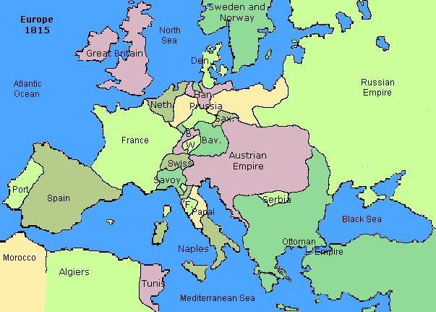
EUROPEAN MAP FOLLOWING NAPOLEON’S REIGN

Slide 4
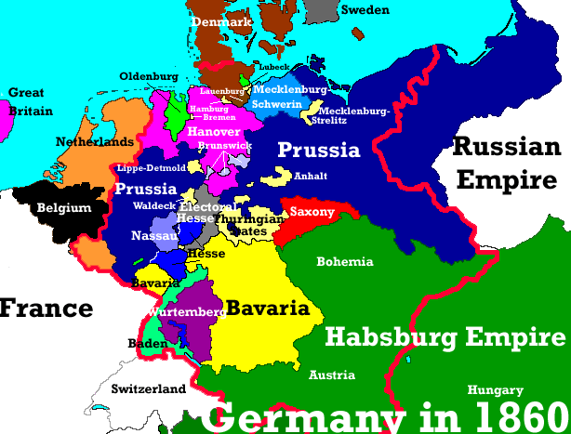
Bismarck began strengthening the Prussian military and, in 1864, invaded Denmark. Once he defeated Denmark, he turned his attention to Austria.

Slide 5
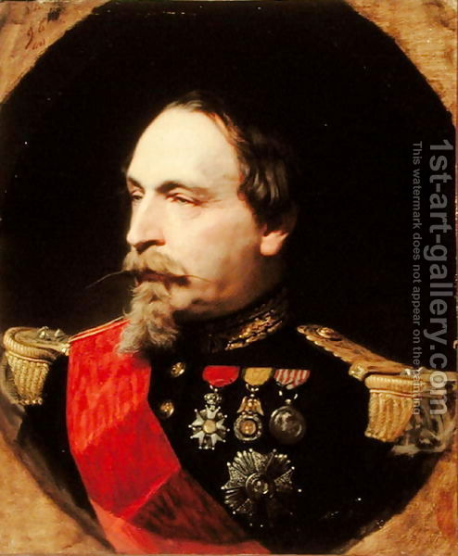
In 1866, Prussia invaded (22)Austria and soundly defeated them in a mere seven weeks (Seven Weeks War). Bismarck took several more German states and his unification efforts were well under way.
The aggressiveness of Prussia worried French ruler Napoleon III. There had
already been a growing rivalry
between the two countries and
it will lead to the eventual start
of the Franco-Prussian War in
1870.

Slide 6
Bismarck will cause this war by editing what is known as the “Ems Dispatch.” This was a telegram that reported on a meeting between Prussian Emperor William I and the French ambassador.
Bismarck made the Ems Dispatch sound insulting to both the ambassador and French people. This angered the French government and led to a declaration of war on Prussia.
The war was swift and devastating as the Prussian army crushed the badly organized and poorly supplied French military. The French were forced to accept a humiliating peace treaty.

Slide 7
23. Causes of the Franco-Prussian War
23A. The Ems Dispatch, which was an insulting telegram to the French
23B. Prussian aggressiveness throughout Europe was causing an uneasiness
23C. There was already a tense, growing rivalry between France and Prussia

Slide 8
24.
What did these three events lead to?
1. Appointment of Otto von Bismarck as Chancellor
2. Austro-Prussian War, 1866
3. Franco-Prussia War, 1870-1871-
24. The unification of Germany

Slide 9
(Following the defeat of France) In January, 1871, German nationalists celebrated the birth of the Second Reich, or empire. (It was called this because Germans considered the Holy Roman Empire to be the First Reich.)
A two-house legislature was created consisting of the Bundesrat and Reichstag.
Reichstag - (Lower house) Filled by the people
Bundesrat- (Upper house) Filled by appointments from the rulers of the German states and could veto any Reichstag decision
**Power remained in the hands of the emperor and chancellor as a result of this.

Slide 10
STRENGTHENING GERMANY
After their unification, Germany emerged as an industrial giant in Europe. This was due in great part to the fact that Germany had founded many large companies that served as a base for future expansion.
The German government also did several things to promote economic development:
Issued a 25. single currency- money
Reorganized the national 25.banking system

Slide 11
Bismarck also pursued several foreign policies, the most significant being to keep France as 26.weak and isolated as possible.
Bismarck’s merciless foreign policy, coupled with his strict domestic (home) policies, earned him the nickname “Iron Chancellor.”
Bismarck instituted the “Kulturkampf” in an attempt to 27.eliminate opposition and empower the government…
The Kulturkampf was a series of laws aimed at limiting the 28. power of the Roman Catholic church.
This plan backfired as German Catholics were devoted to their faith. The church actually gained power in the government as a result of Bismarck’s actions
29. Catholic Church in Germany

Slide 12
They (the Socialists) were demanding a parliamentary democracy and better working conditions for the working class.
He tried to weaken the socialists by wooing workers away from socialism by sponsoring laws to protect them.
Bismarck also supported government benefits for workingmen in his domestic policies because he wanted to prevent 30.workingmen from supporting the growing socialist movement
His plan was at least partially successful, but, ultimately, did not stop the growing socialist movement in Germany.

Slide 13
Below is a quote from Otto von Bismarck.
“Give the workingman the right to work as long as he is healthy, assure him care when he is sick, and maintenance when he is old… then the socialists will sing their songs in vain, and the workingmen will cease to flock to their banner.”
The main idea of the Bismarck quote above is that 32. Bismarck offered workers benefits hoping to steer them away from socialism

Slide 14
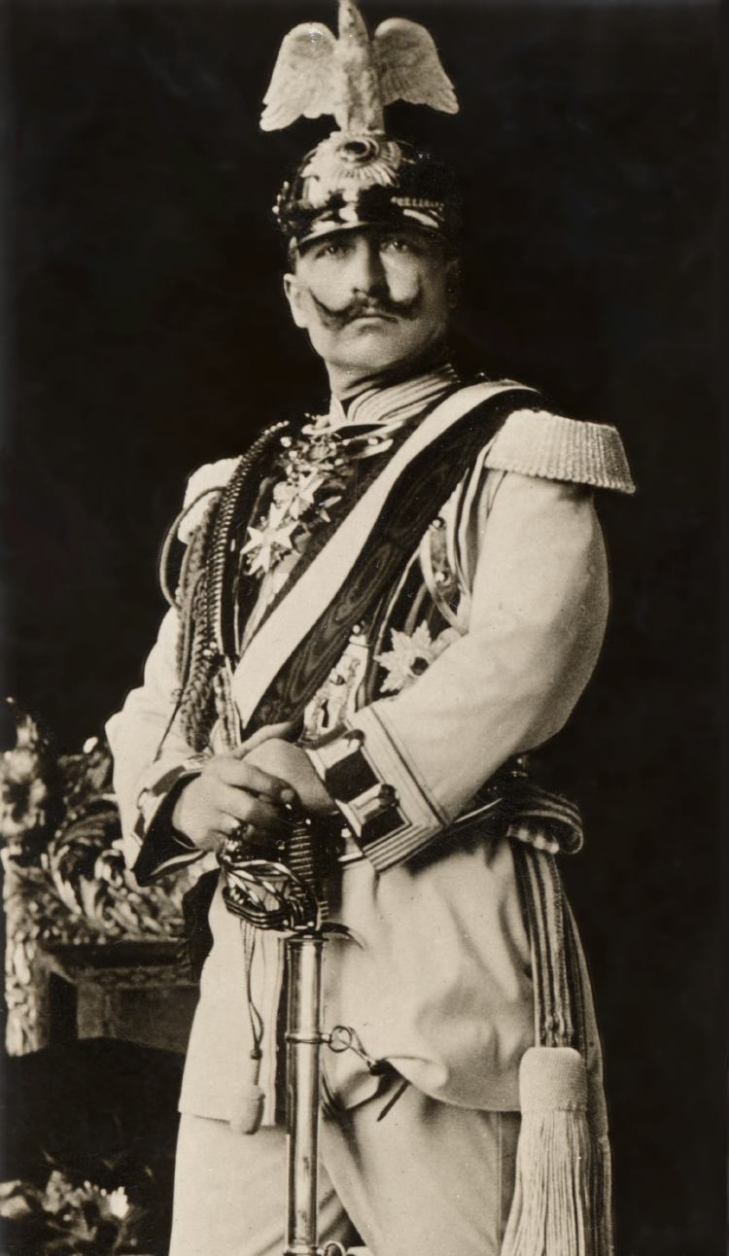
In 1888, William II became Kaiser, or emperor, of Germany. He shocked all of Europe by asking Bismarck to resign as chancellor. He did this for two main reasons:
33. He felt threatened by Bismarck and didn't want any power struggle
German Kaiser William II
(aka Wilhelm II)

Slide 15
Great Britain
While other European countries were facing revolutions, Great Britain continued to prosper.
They avoided revolutions by giving the middle class people more rights and strengthening their economy.

Slide 16
Napoleon III
After the revolutions of 1848 in France, Napoleon III was elected president of the new republic.
Then in a plebiscite (popular vote) the people voted to allow Napoleon III to become their emperor.
He then established an authoritarian regime in which he consolidated most of the power.
This allowed Napoleon III to help France modernize by building new industry and growing the economy.

Slide 17
The fall of the Second Empire
By the 1860’s opposition had begun to grow within France. As a result, Napoleon III began to liberalize his policies.
However, after France’s defeat in the Franco-Prussian War the Second Empire fell.

Slide 18
Austrian Empire
Although the Austrian Empire had managed to crush the revolution of 1848, Nationalism among these groups weakened Austria and resulted in their defeat against the Prussians.
As a result, the Austrians had to allow Hungary to have their own constitution, legislature, and capital.
This created a dual monarchy that had separate governments but the same army, foreign policy, and finances.

Slide 19
Austria/Hungary
Austrian & Ottoman Empires were similar because of their 34.multinational populations.
After making reforms, the Austria and the Hungary governments shared the same 35. Monarchy
Austria created a 36.Dual Monarchy with Hungary

