Slide 1
A Place Called Mississippi
Chapter 5: Antebellum Mississippi
STUDY PRESENTATION
© 2013 Clairmont Press

Slide 2
Section 1: Heartland of the Cotton Kingdom
Section 2: Chattel Slavery
Section 3: Slavery, State’s Rights, and Secession

Slide 3
Section 1: Heartland of the Cotton Kingdom
Essential Question: How did location and technology affect cotton production in Mississippi?

Slide 4
Section 1: Heartland of the Cotton Kingdom
What terms do I need to know?
plantation
cotton gin
Mexican-Petit Gulf seed
tutor
section
sixteenth section funds
Chickasaw school funds

Slide 5
Introduction
Before the Civil War, southerners referred to their social and cultural traditions as “the southern way of life.”
To most white Mississippians, “southern way of life” meant living on a plantation.
Plantations were associated with wealth, social prestige, and class.
Springfield Plantation, Jefferson County

Slide 6
Eli Whitney’s Cotton Gin
Eli Whitney invented the cotton gin in 1793; it was a relatively simple machine that separated cotton fiber from cotton seeds, saving time and labor.
The cotton gin is arguably the most important machine in southern history.
A cotton gin in operation.

Slide 7
Mexican-Petit Gulf Cotton
With an inexpensive method of ginning available, Mississippi looked to find a type of cotton that would grow well.
It had been known that Mexican cotton would grow well in Mississippi’s climate, but Mexican officials had forbidden the exportation of cotton seeds.
After a visit to Mexico, a Natchez planter named Walter Burling returned will several dolls stuffed with cotton, and cotton seeds.
Dr. Rush, a planter and scientist, took the seeds from within the dolls and developed the Mexican-Petit Gulf seed.
Cotton became prominent, replacing tobacco, indigo, and hemp.
Mississippi became the Heartland of the Cotton Kingdom.

Slide 8
The Cotton Economy
The plantation system and the cotton economy influenced almost every aspect of life in antebellum Mississippi.
Social affairs, political affairs, and school terms were determined by cotton picking and planting seasons.

Slide 9
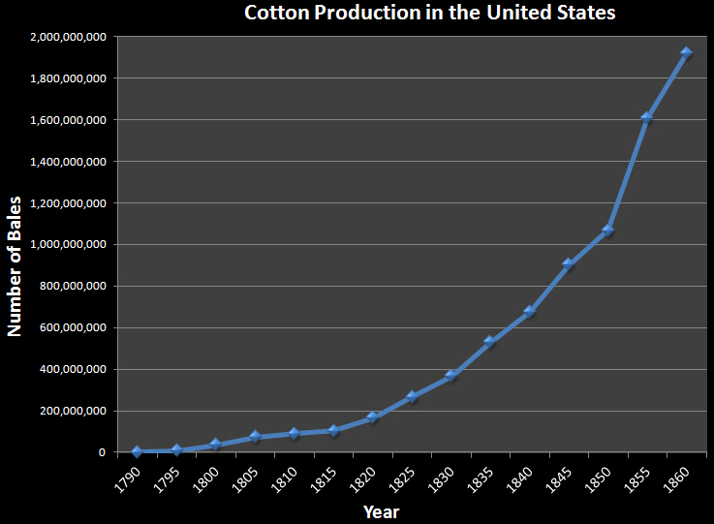

Slide 10
The Cotton Economy: Large Planters
Large planters were slave holders who owned fifty or more slaves and farmed at least five hundred acres of land.
Large planters were a minority of Mississippi’s population, but they dominated the state economically and socially.
Most large planters were Whigs who tried to keep controversy over slavery to a minimum; they feared that continued agitation would lead to secession and war.

Slide 11
The Cotton Economy: Small Planters
Small planters owned between twenty and fifty slaves and farmed between two hundred and five hundred acres.
Small planters hoped to be as successful as large planters, and they wanted to increase their land holdings and slave count.
Many small planters were Democrats who felt threatened by the abolitionist movement.
Small planters supported the expansion of slavery west; this expansion would make it possible for them to acquire more land.

Slide 12
The Cotton Economy: Farmers
Small farmers owned less than twenty slaves and farmed less than two hundred acres of land.
Farmers made up the largest group of slave owners in Mississippi.
Like small planters, farmers dreamed of becoming wealthy and were in favor of slavery expansion westward.
Because of their numbers, small farmers were a powerful political force during the 1850s.
The abolition of slavery crushed their hopes of becoming wealthy.

Slide 13
Education in the Cotton Kingdom
Most school-aged children in antebellum Mississippi lived on farms scattered throughout the state.
Farming required little formal education, so there was little demand for a public school system.
Tutors, private teachers, were hired for the children of planters.
There were some private academies in the state, and some children were sent to college in the Northeast or in Europe.

Slide 14
Education in the Cotton Kingdom: Limited Educational Opportunities for Women
In antebellum Mississippi, there were private schools for girls but no state-supported colleges for women.
Many believed that women in the Old South were meant to serve at home, tending to the needs of husbands and children.
Many people of power thought that women did not need a formal education, as they did not have the intellectual capacity to “comprehend as the male.”

Slide 15
Education in the Cotton Kingdom: Prohibited Educational Opportunities for Slaves and Free Blacks
There were no public or private institutions in antebellum Mississippi that provided education to its slave population or to free blacks.
There was a school conducted briefly for “children of color” in Natchez by Thomas Jones, but it was closed after Jones was arrested.
There was a state law prohibiting the education of slaves, but some free blacks did acquire an education.

Slide 16
Education in the Cotton Kingdom: Sixteenth Section Funds
In 1798, the Mississippi Territory was surveyed and divided into townships, which were further divided into sections.
The income from the lease of every sixteenth section in the township is called sixteenth section funds.
Sixteenth section funds were used in support of local public schools.
Franklin Academy, established at Columbus in 1821, was the first public school supported by sixteenth section funds.

Slide 17
Education in the Cotton Kingdom: Chickasaw School Funds
The Chickasaw Cession of 1832 was not divided into townships and sections, so the government set aside thousands of acres of land to be used as the sixteenth section lands.
The counties established within the Chickasaw Cession received Chickasaw school funds from the lease of the school lands.

Slide 18
Education in the Cotton Kingdom: The University of Mississippi
When Mississippi became a state, the United States Congress granted a township of land to the state for the purpose of building a university.
After years of disagreement over the university’s location, the university was established in 1844 at Oxford.
The University of Mississippi opened in 1848.
The Lyceum (1848) was one of the first buildings on the campus of the University of Mississippi.

Slide 19
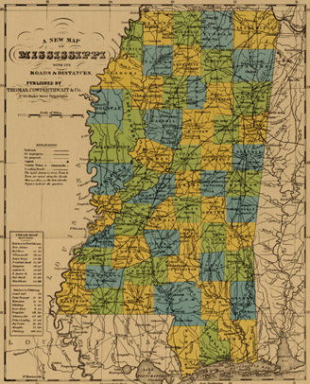
Towns in Antebellum Mississippi
Most people in antebellum Mississippi lived on plantations and farms, but there were several towns and cities in the state.
Towns grew slowly in antebellum Mississippi.
Click map for larger view of 1852 map.

Slide 20
Section 2: Chattel Slavery
Essential Question: How did the beliefs and ideals of people affect their attitude about slavery?

Slide 21
Section 2: Chattel Slavery
What terms do I need to know?
chattel slavery
overseer
driver
slave quarters
slave codes
praise meeting
American Colonization Society

Slide 22
Introduction
Mississippi’s Constitution of 1817 established a labor system called chattel slavery.
Chattel slavery meant that, by law and custom, African American slaves were the personal property of their owners and could be bought, sold, traded, and inherited.

Slide 23
Origin of Slavery
The ancient civilizations of Egypt, Greece, and Rome all practiced human captivity and servitude, called bondage.
Europeans brought the institution of slavery with them to the New World.
The first African America slaves were brought by the English to Jamestown, Virginia, in 1619.
The French used both Indian slaves and African slaves to till southern soil in Mississippi, but African American slaves became the most used.

Slide 24
Increase in Slave Population
Slaves made up the minority of Mississippi’s population until the 1830s, when millions of acres of land were turned into cotton fields.
By 1840, slaves outnumbered whites 195,211 to 179,074.
Over the next twenty years, the black population continued to grow faster than the white population.

Slide 25
Slave Owners
Most sources have recorded that 30,934 Mississippians were slave owners.
Approximately 176,375 whites belonged to the slave-owning class.

Slide 26
Types of Slaves
There were three types of slaves in antebellum Mississippi: field slaves, house slaves, and town slaves.
The lives of slaves were largely determined by their status.

Slide 27
Types of Slaves: Field Slaves
The largest group of slaves were field slaves, which included both men and women.
Children began work at around five or six years old; they performed tasks that did not require much strength or endurance.
Field slaves were assigned specific jobs, worked long hours, and were under the control of an overseer.
In the off-season between harvesting and planting, field slaves performed additional chores.

Slide 28
Types of Slaves: House Slaves
House slaves included cooks, housekeepers, butlers, gardeners, carriage drivers, and traveling companions.
House slaves were often given special treatment and privileges not available to field slaves.
House slaves were sometimes resented by field slaves because of their better quality of life and the special treatment given to them by their owners.

Slide 29
Types of Slaves: Town Slaves
Town slaves made up the smallest group of slaves; they lived in towns and cities.
Town slaves included carpenters, cooks, butlers, blacksmiths, day laborers, and those who worked in bathhouses and hotels.
Most town slaves lived in a small enclosed section of town called the slave quarters, rather than in the houses of their owners.
Town slaves were signaled to return to the slave quarters after work, and the quarters were enclosed well.
Town slaves were usually hired or rented by their owners, and a portion of the wages they earned were kept by their owners.

Slide 30
Plantation Management and Police Control
Planters who owned more than thirty slaves usually employed an overseer; overseers enforced slave codes and maintained order.
Slave codes restricted slaves in a number of ways.
Slaves were severely and cruelly punished for crimes and misbehavior.
There was a clearly defined reward and punishment system on most Mississippi plantations.

Slide 31
The Slave Family
Most slaves in the American South lived in family units; family ties and blood kinship were very important to slaves, and they made great efforts to keep their families together.
Food, clothing, and other provisions were distributed to families on almost all Mississippi plantations.
The values, ideals, morals, and self-image of slaves were shaped and molded in the slave quarters.
Slave parents worked to build their children up with a positive self-concept and self-esteem.
The white world was a slave’s secondary environment; slaves judged each other not by how they conducted themselves within the white community, but within the slave community.

Slide 32
Religion among the Slaves
Religion was the second most important element of slave life in the quarters.
Slaves’ faith and hope of deliverance helped to sustain them during their years of bondage.
On most plantations, slaves went to church with white people; after the formal services, slaves usually conducted their own religious ceremonies called praise meetings.
At praise meetings, slaves could truly express themselves through songs, chants, spirituals, and dances, unrestrained.
These ceremonies acted as an escape for slaves and helped them to preserve some of their heritage.

Slide 33
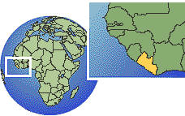
The Mississippi Colonization Society
A branch of the American Colonization Society was established in Mississippi in 1831.
The society intended to assist free blacks who desired to return to Africa.
The Mississippi Society provided assistance to a little over 500 free blacks and brought them from Mississippi to Liberia.
Liberia (flag above) was to be home to freed slaves.

Slide 34
Free Men of Color
In 1860, there were 773 African American men, women, and children in Mississippi who were not slaves.
These men, women, and children were designated by law and custom as “free men of color,” but their rights and privileges were still restricted.

Slide 35
Free Men of Color: Restrictions of Free Blacks
In 1831, free blacks were required to leave Mississippi after a slave revolt led by Nat Turner; a law passed in 1842 prohibited the immigration of additional free blacks into Mississippi.
Free blacks with good character references from local authorities were allowed to remain in the state.
Most free blacks were descendants of former slaves, but some had been freed by their owners, and others had saved up enough money to purchase their freedom and the freedom of their families.
Some white Mississippians were worried that the presence of free blacks might create a desire for freedom among the slaves in bondage.

Slide 36
Free Men of Color: William Johnson
William Johnson was the most prominent free black in Mississippi.
Johnson owned several barbershops, five houses, a delivery service, a thousand acres of land, and fifteen slaves.
Johnson was one of the most successful businessmen in Natchez.
In 1851, William Johnson was killed by a neighbor over a land dispute.

Slide 37
Runaways and Slave Resistance
African American slaves showed resistance to their bondage and mistreatment in many different ways.
The most common resistance shown by slaves was running away, but their chances of escaping were not very good.
Slaves also displayed their hatred by causing fires and neglecting animals and equipment; in extreme cases, murder, poisoning, and violence against slave owners occurred.

Slide 38
Rumors of Slave Revolts
In the summer of 1835, rumors of a slave revolt spread through Madison, Hinds, and Warren County.
Slaves or white strangers who acted suspiciously were questioned, and several of those questioned were hanged as a result of the hysteria.
Weeks after the Civil War began, rumors of a massive slave revolt in Natchez spread.
Response to the rumors of the slave revolt in Natchez were met quickly and severely.
Throughout the Civil War, there were sporadic and isolated slave uprisings in the South, but there were no organized massive rebellions.

Slide 39
Section 3: Slavery, States’ Rights, and Secession
Essential Question: How did people’s beliefs and ideals affect their view of states’ rights in America?

Slide 40
Section 3: Slavery, States’ Rights, and Secession
What terms do I need to know?
states’ rights
natural rights
Ordinance of Secession

Slide 41
Introduction
In the 1830s, the Deep South was greatly affected by the Second Great Awakening, a religious revival.
The South is known as the “Bible Belt,” and Mississippi is called the “Buckle of the Bible Belt.”
Churches were characterized by their intensity, or fervor, and their acceptance of the literal interpretation of the Bible.
The concepts of good and evil, reward and punishment, and heaven and hell were upheld by churches.

Slide 42
Introduction, continued
Politicians and newspapers also influenced how antebellum Mississippians looked at their world.
Politics brought excitement but kept the people stirred up almost constantly.
Newspapers took sides, exaggerated, and did not offer a calm analysis of situations.
In 1861, Mississippians were advised by their political, religious, and editorial leaders that they faced one of two choices: submit to the North, or secede from the Union and form a southern nation.

Slide 43
The Evolving Defense of Slavery
When Mississippi was admitted to statehood in 1817, many whites considered slavery to be an evil practice, worthy of being abolished.
In 1818, the Supreme Court ruled that since slavery was already in Mississippi, it would remain there without question.
As cotton became more important to Mississippi’s prosperity, the attitude of Mississippians about slavery changed dramatically.

Slide 44
The Evolving Defense of Slavery: A “Necessary Evil”
The institution of slavery meant that cotton could be produced in greater abundance, quickly, and effortlessly, bringing wealth to owners.
Mississippians began to think of slavery as an unfortunate but necessary evil.

Slide 45
The Evolving Defense of Slavery: A “Positive Good”
William Lloyd Garrison established an abolitionist newspaper called The Liberator in 1831.
The newspaper condemned the institution of slavery and slave owners, which angered southerners and strengthened their defense of slavery.
Mississippi Senator Robert J. Walker violently spoke against the newspaper, abolitionists, and northern politicians who attacked slavery.
Whites justified slavery by economic, religious, philosophical, and racial terms.
Mississippians defended slavery not as an evil or necessary evil, but a positive good.

Slide 46
The Evolving Defense of Slavery: Argument for Expansion into the Western Territories
The expansion of slavery into western territories acquired after the Mexican War was an intense element of debate.
Southerners argued that if slavery was restricted to the South, slaves would fearfully outnumber whites; they also feared that a slave surplus would cause them to lose money.
White southerners thought that the expansion of slavery westward was essential to their economic survival.

Slide 47
Contrasting Views in the North
The American Revolution popularized the belief in natural rights - or those rights granted to all men, everywhere, which are endowed by God and nature with the rights of life, liberty, and property.
After the American Revolution, northern states eventually abolished the institution of slavery.
In the South, slavery became the symbol and focus of the many differences between the northern and southern states.

Slide 48
Election of Abraham Lincoln, 1860
The relationship between free states and slave states was at a breaking point as the nation approached the 1860 presidential election.
The Republican Party nominated Abraham Lincoln, the Democrats nominated John C. Breckinridge, and the Constitutional Union Party nominated John Bell.
Lincoln won the majority of votes in the electoral college and was declared president of the United States.

Slide 49
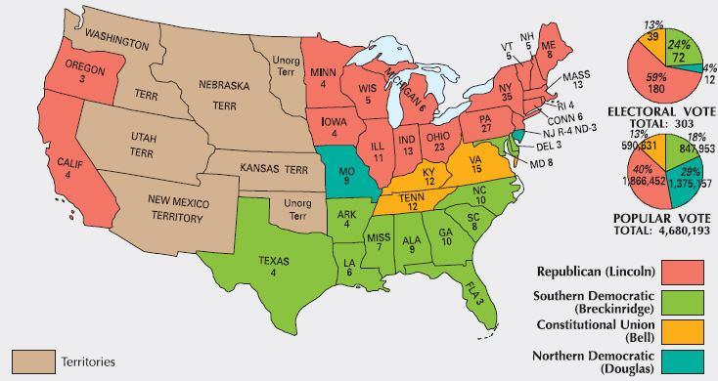
1860 Presidential Election

Slide 50
Mississippi Secedes from the Union
Many southerners predicted that the South would secede from the Union if Lincoln was elected.
Mississippi was the second state to secede when it adopted the Ordinance of Secession, and the state based its secession on the theory of states’ rights.
Most Mississippians believed that the North would allow the South to leave the Union peacefully and did not believe that keeping the Union together was worthy of a war.
Mississippi Governor John J. Pettus strongly miscalculated the possibility of a war.
A Civil War did occur, and approximately 600,000 Americans were killed.

Slide 51
Image Credits
Slide 1: allstarecho on Wikimedia Commons; Slide 2: Public Domain Wikimedia Commons; Slide 27: Library of Congress: Image Credits slide: Eskimo.the on Wikimedia Commons; Graphs are copyright Clairmont Press; all other images Public Domain
Return to Main Menu

