Slide 1
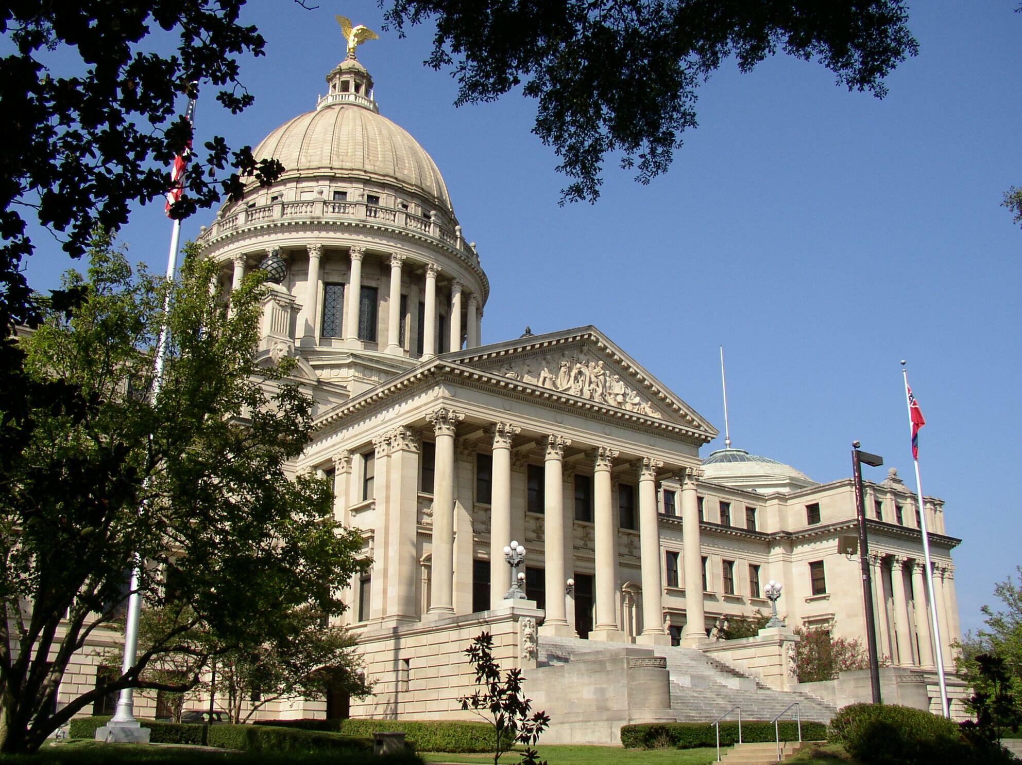
A Place Called Mississippi
Chapter 4: From Territory to Early Statehood 1798- 1860
STUDY PRESENTATION
© 2013 Clairmont Press

Slide 2
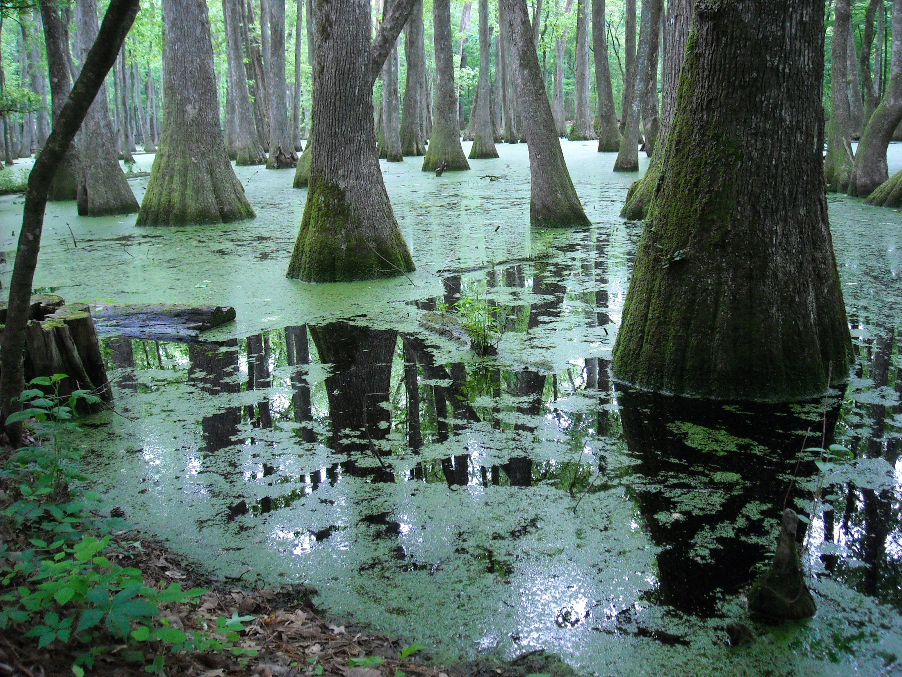
Section 1: The Mississippi Territory 1798-1817
Section 2: Early Statehood 1817- 1845
Section 3: Events Leading to Secession 1845- 1860

Slide 3
Section 1: The Mississippi Territory 1798- 1817
Essential Question: What events led to Mississippi’s statehood?

Slide 4
Section 1: The Mississippi Territory 1798- 1817
What terms do I need to know?
  Northwest Ordinance of 1787
  Natchez Trace
  flatboat
  Devil’s Backbone
  Louisiana Purchase
  annexation
  Mississippi Constitution of 1817

Slide 5
Washington, the Territorial Capital
At first, the capital of the territory was Natchez.
The location of the capital was debated greatly and eventually moved to Washington.
Washington did well and the population grew to about 1,000 people.

Slide 6
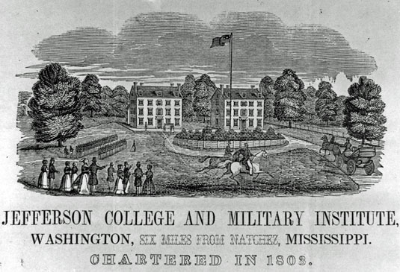
Jefferson College and Elizabeth
Female Academy
In 1802, Jefferson College became Mississippi’s first state-supported college.
Some historians consider Elizabeth Female Academy to be the first college for females in the nation.
The most famous person to attend Jefferson College was Jefferson Davis, president of the Confederate States of America.

Slide 7
The Great River and the Devil’s Backbone
The two main routes into the Mississippi Territory, the Mississippi River and the Natchez Trace, were full of bandits.
The first public building in Mississippi was a jailhouse.
Slow-moving boats were easy prey for robbers, but steamboats eliminated the need for them.
Swift, gruesome justice deterred robbers and river pirates.
In 1801, the Natchez Trace was made an official mail route and therefore made much safer.

Slide 8
The Louisiana Purchase
President Thomas Jefferson asked to purchase New Orleans from France.
Napoleon offered him the entire territory for 3 cents an acre, and Jefferson agreed.
The purchase doubled the size of the United States.
In 1803, the Louisiana Territory was officially transferred to the United States.

Slide 9
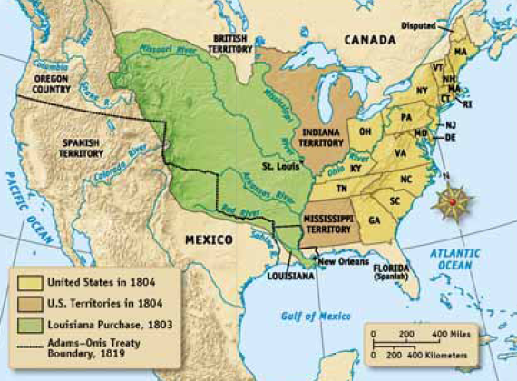
The Louisiana Purchase

Slide 10
Annexation of the Gulf Coast
In 1810, Americans captured a Spanish fort and established the Republic of West Florida.
They immediately asked to annex it, but President James Madison said it was already part of the United States.
Spain was in war with France and unable to dispute this claim.
The Florida Territory was officially made part of the United States.

Slide 11
The War of 1812
Although the War of 1812 was between France and England, to Mississippians it was a war between Indians and American settlers.
The British had been making alliances with Indian Nations, promising them that they would return their tribal lands to them if they helped defeat the United States.

Slide 12
The War of 1812: Creek Attacks
The Creek Nation sided with the British.
The Creeks began to attack white settlements and caused widespread panic.
General Jackson was ordered to attack the Creeks.
Whites abandoned their settlements and gathered at the home of Samuel Mims. This later became known as Fort Mims because over 500 people took refuge here from the Indians.
On August 30, 1813, a group of Creek Indians attacked Fort Mims. All but 36 of the refugees were killed.

Slide 13
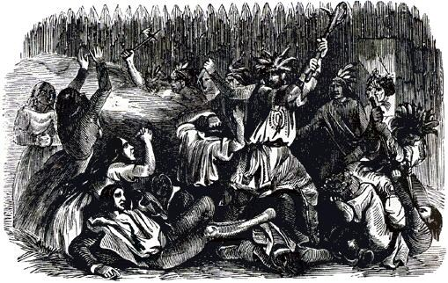
The War of 1812: Heroic Hester
Heroic Hester was a slave woman who was wounded at Fort Mims, but managed to escape the Creek attack.
She travelled to the Mobile River where she found a canoe.
She paddled several miles until she came to Fort Stoddert where she told the soldiers about the Creek attack.

Slide 14
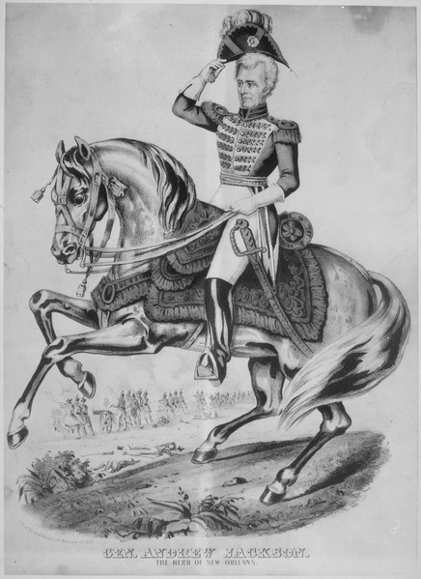
The War of 1812: Defeat of the Creek Nation
General Andrew Jackson defeated the Creek Indians at the Battle of Horseshoe Bend on March 27, 1814.
In the Treaty of Fort Jackson, the Creeks gave up 23 million acres of land to the United States.

Slide 15
The War of 1812: The Battle of New Orleans
The Battle of Horseshoe Bend ended the Creeks’ participation in the War of 1812; General Jackson was sent to New Orleans to protect it from British invasion.
Although the Americans won the Battle of New Orleans on January 8th, 1815, the war was already over.
Neither side had been informed that the war had ended.
Though the war was over, the battle was a great victory for America and historians believe Andrew Jackson’s victory in this battle helped him win the presidential election several years later.

Slide 16
The War of 1812: Pushmataha
Pushmataha was the Choctaw chief who led his warriors into battle with General Andrew Jackson against the Creeks.
While in Washington D.C., the chief became fatally ill with pneumonia.
Pushmataha was buried with full military honors, including ‘the firing of the big guns,’ that he requested from Andrew Jackson.

Slide 17
Mississippi Becomes a State
When the War of 1812 was over, the territory’s population skyrocketed.
The territory grew so much in population it was soon eligible for statehood.
Mississippi was admitted to the United States on December 10, 1817.
Due to property requirements for various offices, such as House or Senate members, wealthy white men controlled the political aspects of the state before the Civil War.

Slide 18
Section 2: Early Statehood 1817-1845
Essential Question: How did sectionalism and slavery play a role in the structure of antebellum Mississippi?

Slide 19
Section 2: Early Statehood 1817-1845
What terms do I need to know?
  sectionalism
  protective tariff
  internal improvements
  Mississippi Constitution of 1832
  flush times
  Missouri Compromise of 1820

Slide 20
Section 2: Early Statehood 1817-1845
Allegiances to local governments and interests, rather than national ones, (sectionalism) caused major division between the various communities within the nation.
Each state’s senators favored policies that were good for their community, and usually disregarded another state’s need.

Slide 21
Causes of Sectionalism
Protective tariffs and slavery were the foremost causes of sectionalism within the United States.
Protective tariffs helped the Northeastern states by adding a tax on goods from other countries so that Americans would buy mostly American-made goods. They did not help Southern farmers because they raised the cost of goods.
In the South, slaves were the primary labor force, while in the Northeast, the working white class was.
Slavery eventually became the most important issue in the nation, and many controversial topics were related to the issue of slavery in one way or another.

Slide 22
Internal Improvements
In 1817, the state’s most abundant natural resource was land.
In order to be able to use this resource, citizens had to be able to get to it.
Rivers were filled with obstructions and there were no roads or bridges.
The first thing the new Mississippi government had to do was appoint the members of the Board of Internal Improvements to construct roads, bridges, canals, and railroads that were to be financed with public money.

Slide 23
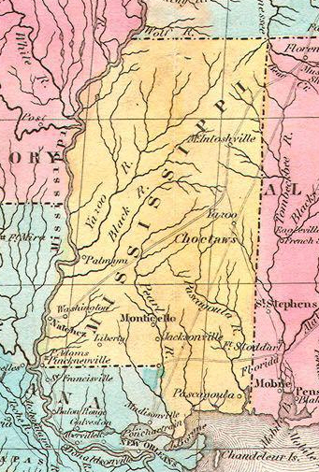
A New State Capital
A special committee was appointed in 1821 to choose a new location for the capital of Mississippi that was as close to the center of the state as possible.
They chose Le Fleur’s Bluff on the Pearl River.
The new capital was named Jackson in honor of General Andrew Jackson.
The state legislature met in Jackson, Mississippi for the first time in December of 1822.
The 1823 Melish map of the United States did not show Jackson, the new state capital of Mississippi.

Slide 24
The Constitution of 1832
The Constitution of 1817 was outdated by the 1830s.
Forty-eight delegates met in Jackson on September 10, 1832 to draft a new constitution.
The new constitution removed the land-ownership requirements from all elected officials and allowed judges to be elected, rather than appointed.
The new constitution still allowed slavery.

Slide 25
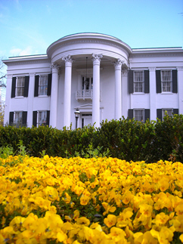
A New Capital and the Governor’s Mansion
The only public building was a tiny wooden one that served as the state capital.
The building couldn’t house the new legislature and there was no place for the governor to live during his term.
The state appointed architect William Nichols to design both the state capital and the governor’s mansion.
The Mississippi governor’s mansion was designed by English architect William Nichols.

Slide 26
Antebellum Politics
Mississippians have always been enthusiastic about politics.
The two major factions in Mississippi politics were the Whigs and the Democrats.
Antebellum political rallies could last all day and included booing and cheering at the candidates during their debates.
Often, candidates had to stand on tree stumps when an actual platform was not available.
Sometimes members of each political party got so emotionally involved in their political rallies that they brought a gun out and began shooting. People were sometimes injured or killed during a political rally.

Slide 27
Flush Times in Mississippi
When the Choctaw and Chickasaw gave up their lands, white settlers rushed to it.
The population grew by over 200,000 people in just 10 years.
Settlers were drawn to the excellent farm land which sold for $1.25 an acre with a minimum purchase of 50 acres.

Slide 28
Source: US Census Bureau
Notes:
What do you notice about the graph? Where are the largest changes?

Slide 29
Flush Times in Mississippi: A Booming Economy
New banks were chartered to help farmers buy land, slaves, and farming equipment.
Inflation was rampant.
Many people established cotton plantations which were well equipped with slave labor.

Slide 30
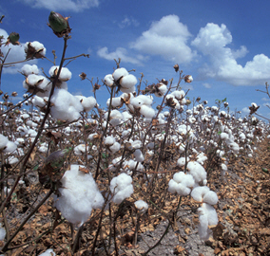
Flush Times in Mississippi: King Cotton
The state grew dependent on only one crop: cotton.
Technological developments increased the demand for cotton from southern plantations.
Cotton could make plantation owners rich in just a few years. This caused many people to abandon their other crops so they could grow cotton.
Cotton and the wealthy plantation owner were the cornerstones of the economy.
Even men who had no land or slaves were enthusiastic in their defense of slavery.

Slide 31
The Missouri Compromise of 1820
Until the 1830’s, there were more abolitionist groups in the South than the North.
The nation was first concerned about the possibility of slavery moving to the new territories.
It was agreed in the Missouri Compromise of 1820 that the states south of the 36° 30’ N parallel would have slavery and that the ones north of it wouldn’t.
For each slave state that was admitted to the Union, there was a non-slave state also admitted to keep the balance between those types of states.

Slide 32
Section 3: Events Leading to Secession 1845-1860
Essential Question: What events caused Mississippi to join the Confederate States of America?

Slide 33
Section 3: Events Leading to Secession 1845-1860
What terms do I need to know?
  Treaty of Guadalupe Hidalgo
  abolitionist
  Wilmot Proviso
  Compromise of 1850
  Fire-eaters
  Kansas-Nebraska Act
  free soilers
  Dred Scott decision

Slide 34
Section 3: Events Leading to Secession 1845-1860
The Missouri Compromise of 1820 was not a permanent solution to the controversy over slavery.
Another compromise was implemented in 1850, but when California and Texas were admitted to the Union, more arguments arose.
Soon, the South began thinking about the possibility of seceding from the Union to form their own country where slavery would be protected by law.

Slide 35
Annexation of Texas
Texas gained its independence from Mexico and asked the United States to annex (join) it.
Most Texans were southerners who had taken their slaves with them to plant cotton.
Texas was so large that some considered breaking it up into five states.
Northerners opposed that because five new slave states would substantially tip the political scales in favor of the slave states.
For 10 years, Texas remained a national issue.
In 1845, both Florida and Texas were admitted as slave states. In 1846, Iowa and Wisconsin were admitted to balance the scale.

Slide 36
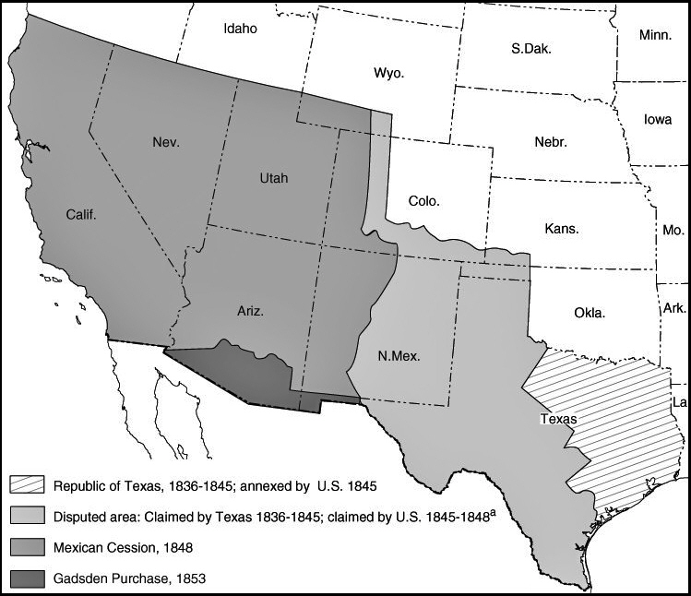
Mexican War, 1846-1848
The United States and Mexico went to war a year after Texas’ secession because Mexico did not recognize Texas’ independence.
Mississippi sent two regiments to fight in the Mexican war.
The Treaty of Guadalupe-Hidalgo of 1848 ended the war.
The United States gained what is now New Mexico, Arizona, Utah, Nevada, and California under the treaty.

Slide 37
Wilmot Proviso of 1846
The Mexican War was popular in the South, and unpopular in the North.
Abolitionists believed the admission of the territories would be used to tip the political power in favor of the slave states.
Pennsylvania congressman, David Wilmot, introduced a bill that would exclude slavery from any territory obtained form Mexico.
The law was not passed.
Southerners became angry and by 1848 were talking about the formation of a new southern nation.

Slide 38
Admission of California
The population of the California Territory grew so rapidly during the Gold Rush that in one year it was eligible for statehood.
Unfortunately, it wasn’t that simple. It had to be decided whether or not the new state would be a free state or a slave state.

Slide 39
“Threatening Relationship”
A group of prominent Mississippians met in May of 1849 to discuss the mounting disagreements between the North and South.
The major issues were the admission of California and southern slave owners right to expand slavery into the new territory.
From this meeting several pro-slave states sent delegates to a convention in Nashville.

Slide 40
“Threatening Relationship”:
Nashville Convention
The Nashville Convention met on June 3, 1850 to find a way to legalize slavery in Utah and New Mexico and prevent California from being admitted as a free state.
Meanwhile, Senator Henry Clay submitted several bills that were meant to ease the growing tension between the free and slave states.

Slide 41
“Threatening Relationship”: Compromise of 1850
Senator Henry Clay, who had played a key role in the Missouri Compromise of 1820, introduced a new pacifying bill known as the Compromise of 1850.
This bill was not made to solve the problem, but simply to calm the waters between the two factions.

Slide 42
Mississippi Election of 1851
The Compromise of 1850 polarized Mississippi.
A special election was held by the state to determine how the people felt about slavery.
The two candidates for governor so strongly disagreed that the Democratic candidate (who wanted to form a new Southern nation where slavery was legal) physically attacked the Union candidate.
Both candidates campaigned zealously, but the Union (who did not agree with secession) won in the end.
Henry Stuart Foote was elected governor in 1851.

Slide 43
Mississippi Convention of 1851
In the same year that Foote was elected governor, a convention that was supposed to discuss the potential secession of the state met.
Mississippi delegates declared that Mississippians should abide by the Compromise of 1850, whether or not they agreed.
They also said that if the citizens and political leaders of Mississippi did not straighten up, the secession from the United States might be a forced one.

Slide 44
Fire-Eaters
At the start of the 1850’s, a group of pro-slave speakers began to make inflammatory speeches throughout the South.
These speakers were able to convince citizens that if they did not keep slavery, they could not maintain the way of life that they enjoyed.
Soon, these speakers, also known as “fire-eaters,” had many southerners seriously considering secession.
Though many Southern leaders tried to speak out against secession, they could not overcome the powerful style and technique of the fire-eaters.

Slide 45
Kansas-Nebraska Act of 1854
The Kansas-Nebraska Act created the Nebraska and Kansas Territories.
It also determined that the slave or free status would be determined by vote of those who lived there.
Free states disliked this law, believing it led to the expansion of slavery, while slave states, of course, were in favor of it.
Both North and South realized the importance of Kansas and many began to move to Kansas.
The settlement of Kansas was a bloody one.

Slide 46
Dred Scott Decision of 1857
The name of the case was Dred Scott v. Stanford.
Dred Scott was taken by his owner into a non-slave state. When his owner died, he was purchased by an abolitionist who encouraged him to file suit with the federal court.
Scott argued that he was free because he had been brought to a free state.
The United States Supreme Court ruled that Scott was the property of the man and that his owner was allowed to bring him wherever he pleased, but he would not be considered free.
The court also asserted that the only way slavery could be abolished was by amending the constitution.
They knew this could not happen at the time.

Slide 47
John Brown’s Raid of 1859
October 16, 1859, John Brown led a raid on the federal arsenal in Harper’s Ferry, Virginia.
His goal was to gather enough weapons to start a slave revolt.
He was caught, tried, convicted, and executed, but the raid made many southerners nervous.
For years, Southerners had feared a slave revolt, but they had never imagined that it would begin with a white man.
They believed that their entire way of life, including their personal safety, was in danger.

Slide 48
The Irrepressible Conflict
After 1859, Americans were tired of compromises.
They believed that the only way the slavery issue could be solved was a war between the two halves of the country.
People in every part of the country were forced to take sides - there was no middle ground.
The majority of Mississippians decided that they would have to secede in order to protect their way of life.

Slide 49
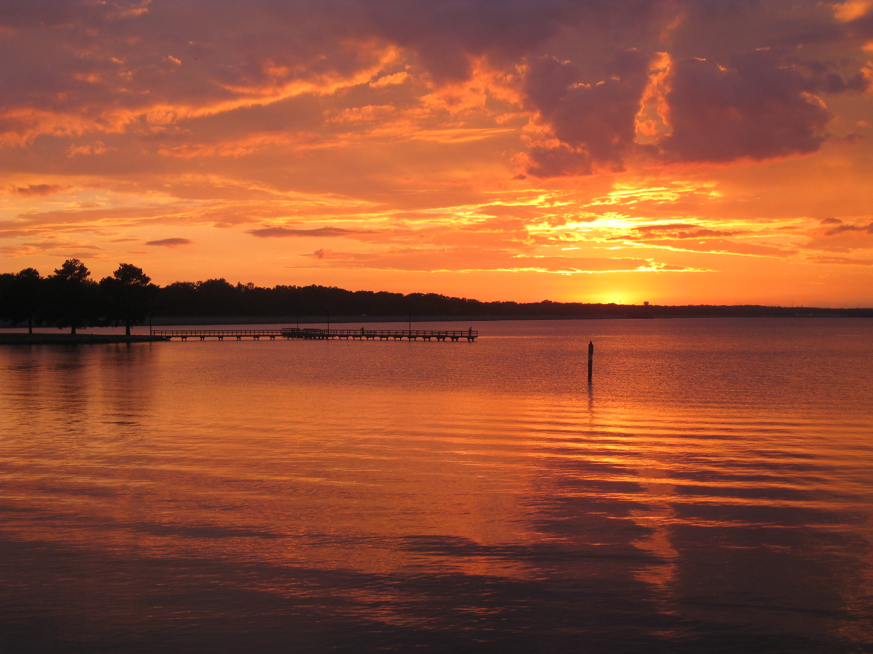
Image Credits
Slide 1: allstarecho on Wikimedia Commons; Slide 2: Public Domain Wikimedia Commons; Slide 14: National Archives and Records Administration; Slide 36: US Government Accountability Office; Image Credits slide: Thomas R. Machnitzki on Wikimedia Commons; all others public domain
Return to Main Menu

