Slide 1
A Place Called Mississippi
Chapter 3: The European Period, 1540-1798
STUDY PRESENTATION
© 2013 Clairmont Press

Slide 2
Section 1: Spanish Exploration
Section 2: French Exploration and the Louisiana Province, 1673-1763
Section 3: Under British Rule, 1763-1783
Section 4: A Spanish Province, 1783-1798

Slide 3
Section 1: Spanish Exploration
Essential Question: How did Spain play a part in the settlement of Mississippi?

Slide 4
Section 1: Spanish Exploration
What terms do I need to know?
cartography
expedition
colony

Slide 5
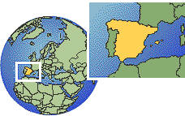
Introduction
Christopher Columbus studied geography and cartography at a school in Portugal.
The king of Spain sent Christopher Columbus on a voyage in 1492, with three ships, crewmen, and supplies.
The 1492 voyage led to the settlement of the “New World.”
Portugal
Spain
Click for larger map.

Slide 6
Hernando de Soto’s Expedition
Shortly after the discovery of the New World, an expedition led by Hernando de Soto came across Mississippi land.
The expedition began what is called the European period, or colonial period, of American history.
Spain, France, and England fought for control of the New World for two hundred years.
Hernando de Soto dreamed of finding riches and being wealthy; he ventured through several states, including Mississippi, on his quest.
Hernando de Soto died along the great river and was buried there.

Slide 7
The Beginning of European Rivalries
Europeans realized that trade and commerce with the colonies would be more profitable than looking for treasure in the New World.
France, Spain, and England began to establish colonies in the New World.
Inland settlements, as opposed to along the fringes or along the coastline, caused rivalry among colonies.
Rivalries eventually led to the removal of the European powers and the creation of the United States.

Slide 8
Section 2: French Exploration and the Louisiana Province, 1673-1763
Essential Question: How did France play a part in the settlement of Mississippi?

Slide 9
Section 2: French Exploration and the Louisiana Province, 1673-1763
What terms do I need to know?
casquette girl
Code Noir
Treaty of Paris of 1763

Slide 10
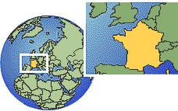
Introduction
The French became interested in finding a shortcut across the New World.
The French learned about the great river that “lost itself in the great sea,” called the “Mississippi” by Indians.
The French realized that control of the great river was essential for trade in the New World; the river would also serve as a barrier to stop westward expansion of English colonies.
France
Click for larger map.

Slide 11
La Salle’s Expedition
The French, led by Sieur de La Salle, celebrated reaching the mouth of the Mississippi River.
The land and tributaries along the river were named the Louisiana Province after Louis XIV.
La Salle planned to establish a settlement at the mouth of the river after a trip back to France, but he sailed too far west.
The French who remained at the mouth of the river grew impatient and returned to Canada.
La Salle realized that he was lost and tried to find the Mississippi River again, but his rebellious crew killed him and then returned to Canada.

Slide 12
The Significance of the Mississippi River
France, Spain, and England saw promise in occupying the Mississippi River.
Each nation tried to establish a settlement at the mouth of the river, but only the French were successful.
The French established Natchez in 1716 and New Orleans in 1718.
During the span of the European period, France, Spain, and England controlled Natchez and the land that makes up modern-day Mississippi.

Slide 13
The Establishment of Fort Maurepas on Biloxi Bay
The French sent Pierre Le Monye, Sieur d’Iberville, to establish a settlement at the mouth of the Mississippi River.
Iberville and his people met a band of Biloxi Indians who took them to their village.
Iberville and his brother Jean-Baptiste Le Moyne searched for the mouth of the Mississippi for weeks; on March 2, 1699, they thought they had found the Mississippi.
Uncertain as to whether or not they had found the Mississippi, Iberville went back to the Gulf Coast and built Fort Maurepas near Biloxi Bay; it served as a capital for a short time.

Slide 14
Bienville Appointed Governor
The capital was moved from Fort Maurepas to Fort Louis on Mobile Bay in 1701.
Bienville became governor of the Louisiana Province.
Bienville encouraged French settlers, especially women, to come to the lower Mississippi valley; the female population of the colony was small, and Frenchmen were marrying Indian women.
Bienville thought that a large mixed population was a threat to the peace and progress of the colony.

Slide 15
The Casquette Girls
In 1704, Bienville arranged for twenty young women to be brought to Fort Maurepas and married to Frenchmen.
The young women did not adjust well to their new conditions, and they vowed to return to France; however, the French captains would not allow their passage back.
The young women were called casquette girls because each was given a casquette, or small suitcase, with a wedding dress and other personal articles.

Slide 16
Fort Rosalie
Bienville wanted to make trade and commerce on the lower Mississippi River safe from Indian attacks.
He led a group of soldiers against the Natchez Indians but eventually negotiated with them.
The Natchez Indians provided materials to create Fort Rosalie, which became a center for French activity.

Slide 17
The Development of the French Natchez District
After Fort Rosalie was established, the prosperity and the population of the Louisiana Province, especially the lower Mississippi valley, increased.
New Orleans became the capital of the Louisiana Province.
The Louisiana Province was separated from the French colony in Canada and was divided into nine districts, three of which later became the state of Mississippi: Biloxi, Yazoo, and Natchez.

Slide 18
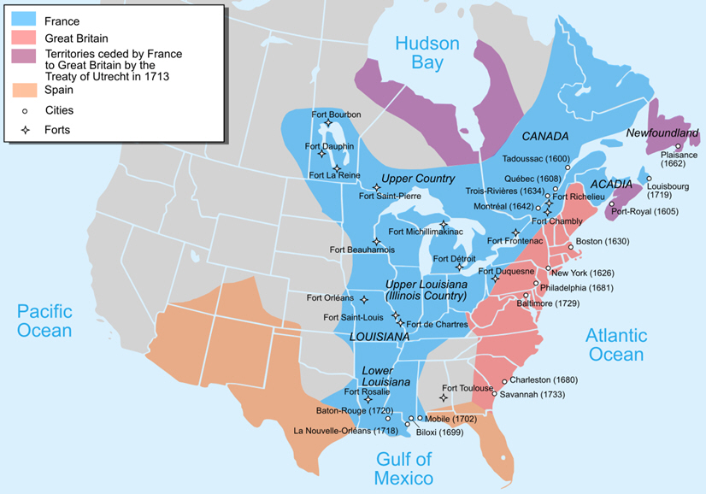
New France 1750

Slide 19
The Code Noir
The French who moved to Louisiana from the Caribbean brought their slaves with them.
Bienville introduced laws regulating the institution of slavery; they were known as the Code Noir and were issued in 1724.
The laws were not as strict as slave codes passed in other areas.
The Code Noir governed slavery in the French colonies.

Slide 20
The Removal of the French from the Mississippi Valley
The Natchez Indians liked the French when they were traders and trappers but took issue when they claimed private land ownership and established large plantations.
The French also had problems with the English who were moving westward and claiming land; the overlapping claims led to war among France, Spain, and England.
The French and Indian War lasted from 1754-1763; it was settled by the Treaty of Paris in 1763.
The Treaty of Paris forced France to give up its land in North America east of the Mississippi River to England, and Spain got the French land west of the Mississippi River.

Slide 21
Section 3: Under British Rule, 1763-1783
Essential Question: How did Great Britain affect the development of Mississippi?

Slide 22
Section 3: Under British Rule, 1763-1783
What terms do I need to know?
Proclamation of 1763
31° parallel
32°28’ parallel
firewater
confluence
indigo
Continental Congress
Loyalist
Treaty of Paris of 1783

Slide 23
Introduction
The Treaty of Paris of 1763 officially gave Mississippi land to England.
The English realized that governing their new, vast land might be difficult.
In order to give themselves time to work out an agreement with the major Indian nations, the English government issued the Proclamation of 1763; it stopped some unwanted migration west, temporarily, and was meant to keep Native Americans and white settlers from fighting over land.

Slide 24
British West Florida
In 1763, the English government divided the former Spanish Florida into British West Florida and British East Florida; British West Florida included part of the land that became the state of Mississippi.
The original boundaries of British West Florida were at a 31° parallel north.
Once the British realized that Fort Rosalie (Natchez) was north of the 31° parallel, they moved the parallel up to the 32°28’ parallel, and it was renamed Fort Panmure.

Slide 25
British Indian Policy
The British held an Indian Congress at Mobile which was attended by many Southeast Indian leaders.
The conference was meant to reach a peaceful agreement between white settlers and Native Americans; it resulted in pledges of friendship and trade agreements.
As a result of the conference, many Indian nations gave large amounts of land to the British.

Slide 26
Development of the British Natchez District
As the population of British West Florida increased, the colony was divided into four districts.
One district created was the Natchez District.
The Natchez District included the area from the flowing together of the Yazoo and Mississippi Rivers.
Former British officers were given thousands of acres of land grants in the Natchez District.
The settlers of the Natchez District grew tobacco, cotton, corn, and indigo.

Slide 27
Natchez during the American Revolution
The thirteen American colonies declared their independence from England in 1776.
After independence, the Natchez District remained loyal to the British.
Most of the prominent citizens in Natchez were former British soldiers and did not support the American Revolution.
William Dunbar, a distinguished citizen in Natchez, introduced science instruments and knowledge to the area.
Natchez was important to the American colonies because of its strategic location.

Slide 28
Natchez during the American Revolution: The Willing Expedition
The Continental Congress sent James Willing, a former Natchez resident, on an expedition to encourage Natchez citizens to join the American cause.
When Willing arrived in Natchez on February 21, 1778, he found that many Natchez were Loyalists and arrested several of them, took some of their property, and took some prisoner.
Willing was ordered to leave the city and take his English captives with him; the Spanish feared a war with the English.

Slide 29
Natchez during the American Revolution: Spain Declares War on England
The American Revolution kept the English on the Atlantic coast and vulnerable to a Spanish attack along the Gulf Coast.
Spain declared war on Great Britain in 1779.
Spain had reoccupied most of Florida within two years of the war.

Slide 30
Natchez during the American Revolution: Natchez Revolt
The British citizens at Natchez did not acknowledge Spanish reoccupation of Florida.
The Natchez residents recaptured Fort Panmure on April 22, 1781, but the Spanish regained the fort on July 23, 1781.

Slide 31
Natchez during the American Revolution: Treaty of Paris of 1783
Under the Treaty of Paris of 1783, the American colonies were recognized as independent, the United States of America.
The British gained control of land west of the Mississippi River according the treaty.
The boundary line between America and Spanish Florida was not clearly settled by the treaty.

Slide 32
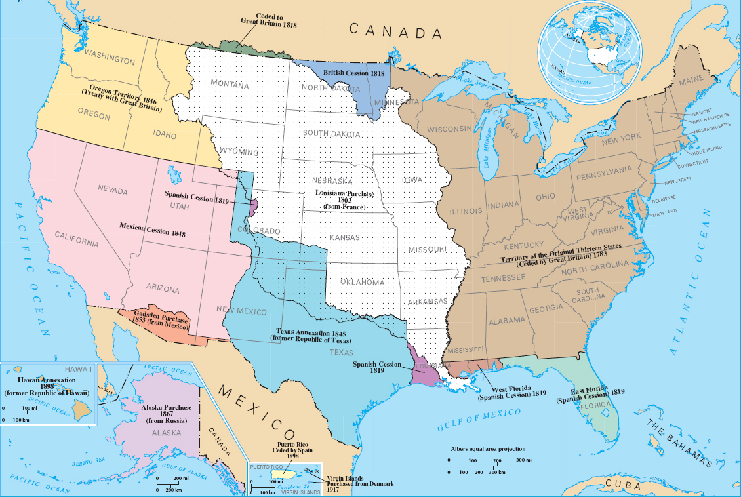

Slide 33
Section 4: A Spanish Province, 1783-1798
Essential Question: What effects did Spanish rule have on the people of Mississippi?

Slide 34
Section 4: A Spanish Province, 1783-1798
What terms do I need to know?
militia
Treaty of San Lorenzo
right of deposit

Slide 35
Introduction
The Natchez District experienced growth and prosperity under Spanish control.
Spain was a Catholic nation, but Jews and Protestants were guaranteed religious freedom by the Spanish government.
The majority of the Natchez District population spoke English rather than Spanish.

Slide 36
Governor Manuel Gayoso de Lemos
Manuel Gayoso de Lemos was appointed governor of the Natchez District in 1789.
Gayoso ruled wisely and had the respect and cooperation of its citizens.
Gayoso became famous for parties and festivities held at his mansion.

Slide 37
Spanish Forts
Fort Rosalie was falling apart when Gayoso came to Natchez.
Instead of repairing Fort Rosalie, Gayoso decided to build several new forts.
Fort Nogales was built in Vicksburg in 1795 and a fort on Chickasaw Bluffs was built the same year.

Slide 38
Population Increase
Population growth in the Natchez District kept up with economic development.
As cotton culture increased, the Spanish encouraged settlers to bring their slaves to the Natchez District; additional land grants were given to slave owners.

Slide 39
Slave Revolt in 1795
Rumors of a slave revolt spread throughout the Natchez District in 1795.
The supposed revolt slave leaders were arrested and killed.
Rumors of the specific slave revolt were ended, but several rumors continued throughout the period of slavery, keeping the Southern whites fearful.

Slide 40
America Acquires Mississippi
In 1795, the Spanish gave up their claim to land north of the 31° parallel.
Under the Treaty of San Lorenzo in 1795, Americans were given free navigation of the Mississippi River, and they were given the right of deposit in New Orleans.
Spain also promised to help keep Native Americans from attacking the American settlements along the Spanish Florida border.
Spanish authorities did not want to leave Natchez but had no reason to stay; Mississippi became an American possession.
From 1798 to 1861, Mississippi became the leading cotton-producing state in America (Heartland of the Cotton Kingdom).

Slide 41
Image Credits
Slide 1: allstarecho on Wikimedia Commons; Slide 2, 18, 19, 32: Public Domain Wikimedia Commons; Image Credits slide: Eskimo.the on Wikimedia Commons
Return to Main Menu

