Slide 1
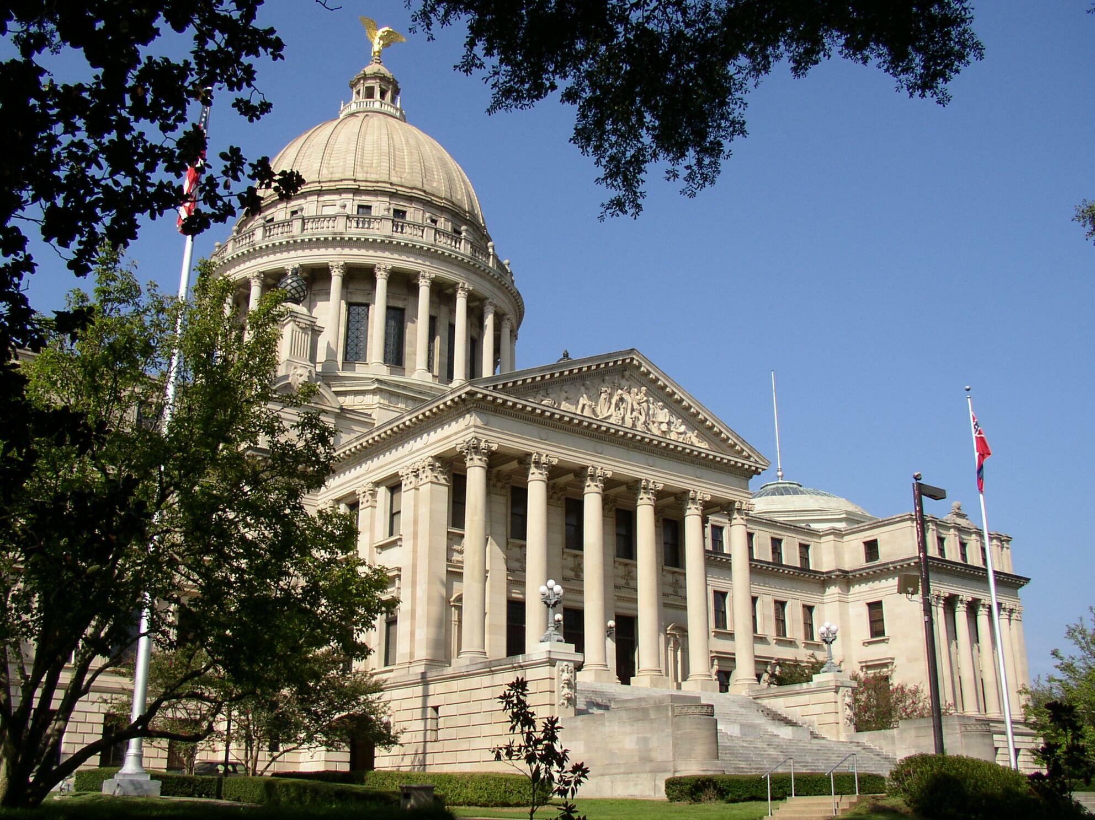
A Place Called Mississippi
Chapter 2: Native Mississippians
STUDY PRESENTATION
© 2013 Clairmont Press

Slide 2
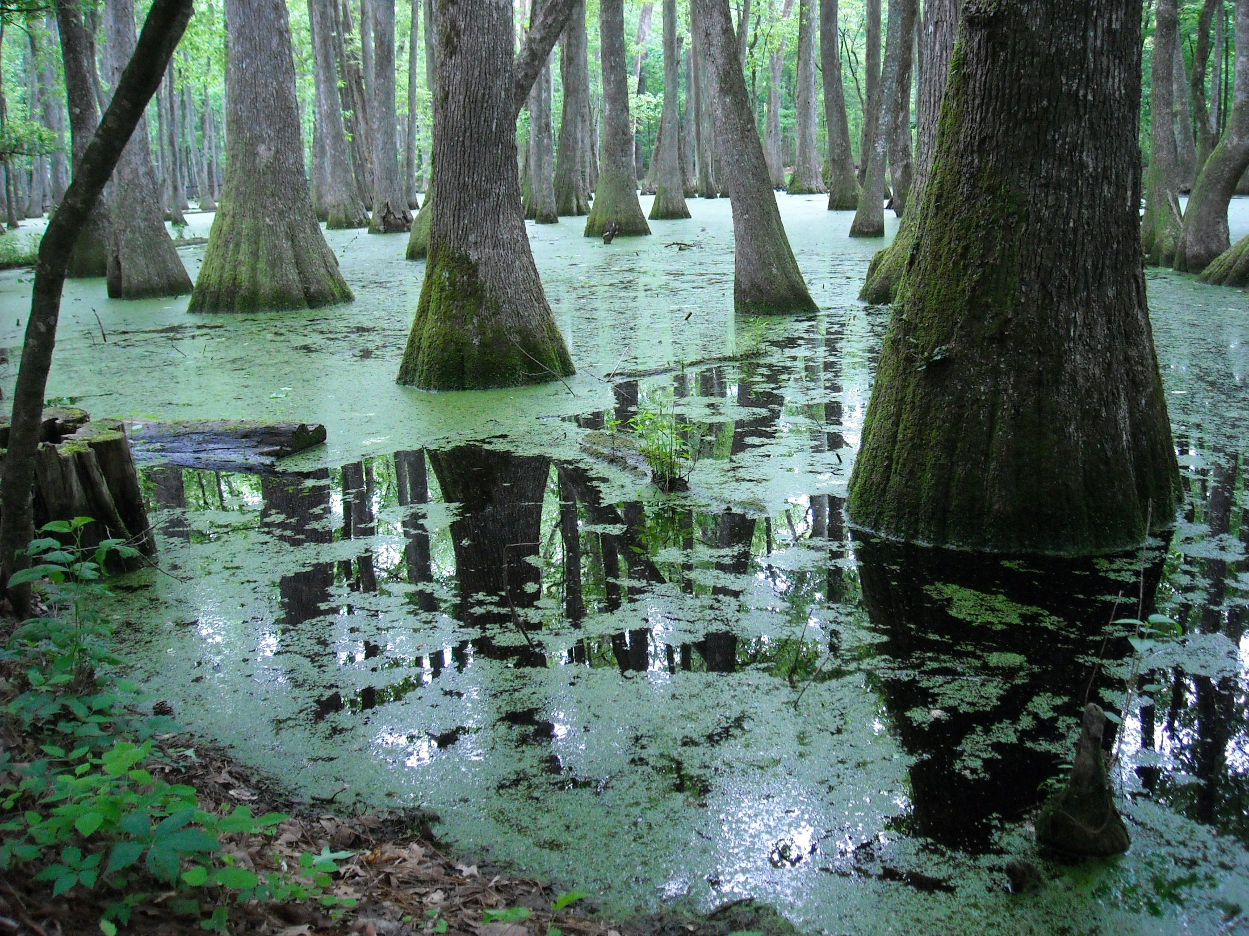
Section 1: A Pristine Wilderness
Section 2: Major Tribes: Natchez, Choctaw, and Chickasaw
Section 3: Small Tribes
Section 4: Indian Removal and the Trail of Tears

Slide 3
Section 1: A Pristine Wilderness
Essential Question: What was life like for Mississippi Natives?

Slide 4
Section 1: A Pristine Wilderness
What terms do I need to know?
  granary
  razorback
  grabbling
  pictography
  matrilineal
  clan
  exogamic
  green corn
  ceremony
  chunkey
  stickball
  mingo
  calumet

Slide 5
Food Gathering
Indians grew beans and squash.
Their most important crop was maize (corn).
Not only was maize able to be cooked many different ways, it could also be stored for long periods of time.
Indians grew their own food and supplemented it with hunting and fishing.

Slide 6
Food Gathering: Hunting
Hunters used disguises and their bows and arrows to capture game.
In 1539, Indians acquired a taste for pork when Hernando de Soto brought pigs from Spain.
When de Soto refused to trade the pigs, Indians would chase the pigs into the woods and capture them.
The ones that got away were believed to have started the razorback population in the southern United States.

Slide 7
Food Gathering: Fishing
Native Mississippians kicked up mud at the bottom of their fishing grounds. This made the fish swim to the top so they could easily be caught.
Indians also stunned the fish by crushing certain herbs and spreading them over the top of the water. The fish would then float to the top.
They also used trot-lines, nets, sieves, and other devices to catch fish.

Slide 8
Language
The dominant southeastern Indian language was Muskhogean.
The two major exceptions were the Biloxi and the Natchez.
They did not have an official system of written communication, although they did use pictography.
Indians did not believe in land ownership.

Slide 9
Family Life
They traced their line of descent through mothers, not fathers.
Their social classes were based on the clan system.
Clans were groups of families with common ancestors.
Clan members had to marry into other clans in huge, ceremonial weddings.
Weddings were more about a political union of families than a romantic one of two individuals.

Slide 10
Religion
All Mississippi Indians had some sort of religion and believed in an after life.
The spirits they believed in were closely related to their environment.
Most of their ceremonies were performed to appease the unfriendly spirits.

Slide 11
Religion: Green Corn Ceremony
This ritual was conducted in late August in hopes of a bountiful harvest.
It is believed this ceremony marked the beginning of a new year and that family feuds were settled during this period.
It often attracted such large numbers of people that temporary shelters had to be made to house everyone.

Slide 12
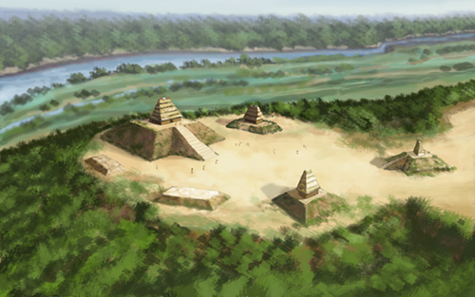
Religion: Burial Traditions
Traditions varied greatly among tribes.
Natchez required human sacrifice at the death of a chief.
Chickasaw buried the dead with their most favorite possessions under the floor of their cabin.
Other tribes used different methods.
The Anna Site is located in Adams County. Construction began on the mounds around 1200.

Slide 13
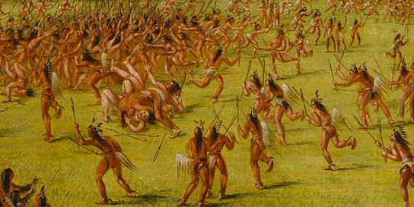
Recreation
Sporting events were highly developed.
Stickball was a very popular sport and had nearly 300 players on each side. Thousands of people would gather to watch.
Stick ball was often called “the little brother to war.”
Women played a less-violent version of the game.
Ball Play of the Choctaws-Ball Up from an oil painting by George Catlin.

Slide 14
Tribal Government
Most tribes had some sort of local government.
Mingos ruled with advice from tribal elders.
In a case of murder, the victim’s family had the right of vengeance. If the murderer escaped, their brother or close relative would be killed in their place.

Slide 15
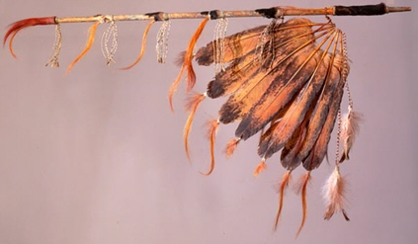
The Calumet
Important meetings were started by smoking the calumet, or peace pipe.
Meetings could only last as long as their calumet lasted.

Slide 16
Section 2: Major Tribes: Natchez, Choctaw, Chickasaw
Essential Question: How did the cultures of the Natchez, Choctaw and Chickasaw differ?

Slide 17
Section 2: Major Tribes: Natchez, Choctaw, Chickasaw
What terms do I need to know?
  refugee tribe
  migration
  agrarian

Slide 18
Section 2: Major Tribes: Natchez, Choctaw, Chickasaw
There were at least twenty Indian tribes that lived in what is now Mississippi.
The most prominent tribes were the Natchez, Choctaw, and Chickasaw.
Smaller tribes were either taken over by larger ones or were migratory.

Slide 19
Natchez
The Natchez Nation, when first discovered by Europeans, had nearly 4,000 people.
The Great Sun was their ceremonial leader, but had no power over the tribes– they ruled themselves.
They were thoroughly tattooed.
They built sacred mounds where they conducted their religious ceremonies.
After de Soto’s exploration, the tribe stopped building mounds.
When a Great Sun died, a man from the village would sacrifice himself to accompany the chief on his journey to the afterlife.

Slide 20
Natchez (continued)
The Natchez and the French, who settled the area, were hostile at first, but soon, trade began to flourish.
As the population grew, the French began to take over too much of the tribal land. The Natchez attacked, killed 200 Frenchmen, and took over their settlement.
Eventually, the French and Choctaw attacked the Natchez and almost completely wiped them out.
Those who were not killed or sold fled to take refuge in neighboring tribes.

Slide 21
Choctaw
In 1700, there were about 20,000 members of this tribe.
Second largest tribe in Mississippi
Most agricultural
Nicknamed “long hairs” and “flat heads” by the Europeans
Different Choctaw tribes believed different origin stories.

Slide 22
Choctaw (continued)
The Choctaw believed that their history and the Chickasaw Indians’ history intertwined; this may explain many similar customs.
The Choctaw were known as the more peaceful of the two nations.
In the 1830’s, Europeans had completely taken over and forcibly removed the Choctaw from their land.

Slide 23
Chickasaw
When the British first began to colonize, there was a population of about 4,500 Chickasaw Indians.
This tribe is remembered for its proud warriors and excellent hunters.
They were English allies and involved in Indian slave trade.

Slide 24
Chickasaw (continued)
The Chickasaw developed their own breed of horse.
They gave refuge to the Natchez who attacked the French.
The French didn’t like this and attacked, but they lost.
Eventually, the Chickasaw were forced to move like so many other native people.

Slide 25
Section 3: Small Tribes
Essential Question: How are the histories of the smaller tribes different from the Choctaw, Natchez, and Chickasaw?

Slide 26
Section 3: Small Tribes
What terms do I need to know?
  band
  merge
  missionary

Slide 27
Section 3: Small Tribes
Many small tribes either merged with other tribes or moved outside of Mississippi.

Slide 28
Acolapissa
When the tribe was first discovered by Europeans in 1699, there were only about 1,000 members of the tribe.
The Acolapissa allied themselves with the French.
Soon, they merged with the Houma tribe of Louisiana.

Slide 29
Biloxi
The tribe migrated to the Gulf Coast shortly before the French landed there.
There were less than 500 members of the tribe, and they migrated several times throughout French colonization.
When chiefs died, their friends and relatives would eat together for many days, remembering him and telling stories.

Slide 30
Chakchiuma
This nation was the little brother of the Choctaw and Chickasaw groups.
It was often caught in the middle of their wars and it is thought that it was eventually divided between the two larger nations.

Slide 31
Grigra
The name for the tribe came from the repeated “gri” and “gra” sounds in their speech.
There were about 200 in the Grigra nation.
They were living with the Natchez at the time of the European discovery.
There is no mention of the Grigra after 1723 when the French burned their temple.

Slide 32
Ibitoupa
Their name meant “people at the source of a stream.”
The 50 people in the tribe had a culture similar to that of the Chickasaw.
The Ibitoupa moved up the Yazoo River until they eventually met with other tribes.
It is believed that they merged with the Chickasaw nation.
They are not mentioned in history after 1730.

Slide 33
Koroa
Part of this tribe lived with the Natchez, while the other half lived along the Yazoo River.
In 1729, the Koroa allied themselves with the Natchez against the French. The Koroa destroyed Fort St. Pierre.
The Koroa were nearly wiped out when the French retaliated. The remaining people merged with other nations.

Slide 34
Ofogoula
The Ofogoula were nicknamed the “dog people” by neighboring tribes.
They spoke a language similar to that of the Biloxi tribe.
They refused to attack Fort St. Pierre with the Yazoo and Koroa, instead they joined the Tunica (French allies).
They later settled near Fort Rosalie and remained there until 1784.

Slide 35
Pascagoula
Called the “bread people” after a special type of bread they made.
Were friends and allies of the French
For nearly a century, there were members of the Pascagoula tribe on the Red River (Texas).
It is believed the Biloxi and Pascagoula tribes merged into the Capinan, or Moctoby, tribe.

Slide 36
Tiou
Some scholars believe that the nation migrated after French colonization to live near the Natchez.
The tribe supported the Natchez attack on the French and they were completely destroyed.

Slide 37
Tunica
They numbered about 1,500 and were the closest ally of the French.
Part of their tribe spent time trading salt across the Southeast.
In 1706, they moved closer to the Houma tribe, who attacked them for supporting the French.
They survived this attack and moved to Louisiana. They are now known as the Tunica-Biloxi tribe.

Slide 38
Yazoo
Close with the Koroa tribe
Anti-French
Almost completely destroyed the French settlement at Fort St. Pierre.
Per French request, the Choctaw attacked the tribe. Not much is known about the outcome, but the tribe is rarely mentioned in the texts that followed.

Slide 39
Section 4: Indian Removal and the Trail of Tears
Essential Question: What beliefs and ideals led to the removal of Native Americans from Mississippi?

Slide 40
Section 4: Indian Removal and the Trail of Tears
What terms do I need to know?
  Indian Removal
  Trail of Tears
  Land cession

Slide 41
Section 4: Indian Removal and the Trail of Tears
The majority of the white settlers who moved to Mississippi were there as farmers.
When they discovered Indians occupied the land, they claimed that they weren’t using it as they should.
The settlers put up such a fuss that by the 1830’s, Indian tribes were being forcibly removed from their land. It began with the Choctaw.
Soon, many other tribes were forced out of their homeland and were sent to the new Indian Territory in Oklahoma.
The long, dangerous journey killed so many Indians that it eventually became known as the Trail of Tears.

Slide 42
Choctaw and Chickasaw Land Cessions
The Choctaw either sold or gave up all of their land to the United States by 1801.
With the money they made from these sales, they bought an area in the Indian Territory.
The Chickasaw gave up their land in the Treaty of Pontotoc in 1832.
The Chickasaw received none of the money promised to them by the United States for the sale of their land.
The tribes believed they had been tricked and when the Civil War began, they sided with the South.
The government still refused to give them their money because they had rebelled against it.

Slide 43
Mississippi Band of Choctaw
The small group of Natives that remained in Mississippi endured great difficulties when trying to retain their culture.
After the creation of the Choctaw Indian Agency at Philadelphia was established, the Bureau of Indian Affairs bought land for a reservation (Nanih Waiya) on which Indians could preserve their traditions and way of life.

Slide 44
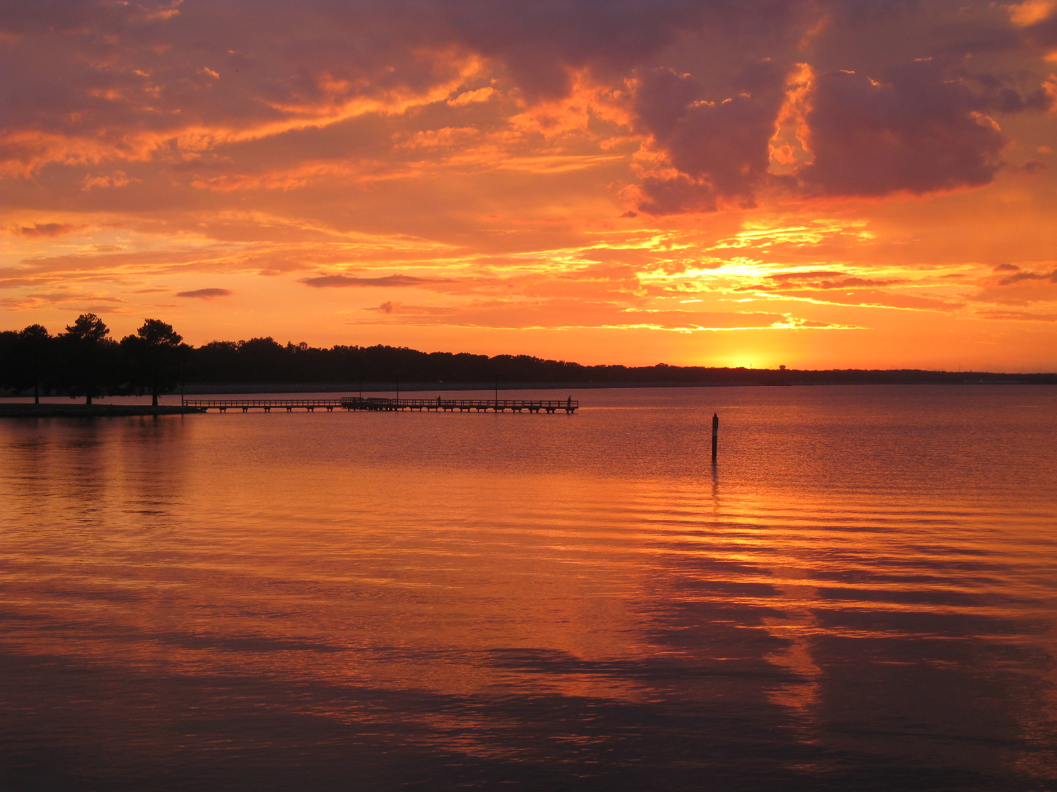
Image Credits
Slide 1: allstarecho on Wikimedia Commons; Slide 2: Public Domain Wikimedia Commons; Slide 12: Herb Roe; Image Credits slide: Eskimo.the on Wikimedia Commons; all others Public Domain
Return to Main Menu

