Slide 1
Chapter 12 The Reach of Imperialism

Slide 2
Lesson 1 --- Colonial Rule in Southeast Asia
What are the causes and effects of imperialism?
How do some groups resist control by others?

Slide 3
Imperialism
When one country or people takes over the political, economic, and social life of another.
Notes:
The years between 1870 and 1914 were the height of the age of imperialism. This was not a new idea. Empires had controlled other countries before the 1800s. What was new was the strength of the modern nations. By 1914 the great powers of Europe, Japan, and the US controlled almost the entire world.

Slide 4
Nationalism
The loyalty and devotion people have to their nation.

Slide 5
Militarism
The belief that a country should maintain a strong military and be prepared to use it to promote national interests.

Slide 6
The New Imperialism
5. Imperialism – the extension of a nation’s power over other lands.
Imperialism had been around since Christopher Columbus in 1492; however in the late 1880’s New Imperialism emerged.
Whereas before nations just set up trading posts and missionary posts, now they wanted to have direct control over other countries.

Slide 7
What were the motivations for the “New Imperialism?”
Economic (Money) Motives
New Markets in which to sell their goods
Raw Materials (Rubber, Oil, and Tin)
Nationalism and Rivalries
There was a race to see who could get the most colonies.
The more colonies a country had, the more power and prestige they had.

Slide 8
New Imperialism
European countries wanted more access to raw materials for their factories
European countries wanted to show their nationalism by acquiring more territory
European countries wanted more markets in which to sell their goods

Slide 9
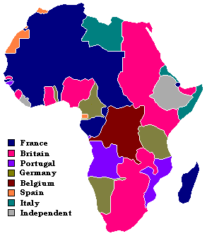

Slide 10
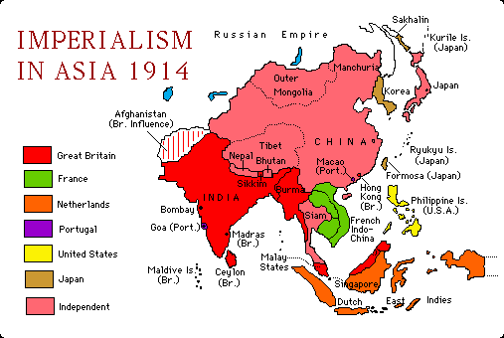

Slide 11
Racism, Social Darwinism, and Imperialism
Imperialism was also driven by racism, the belief that race determines traits and capabilities.
Racists believe that particular races are superior or inferior.
They justified this thinking with 9. Social Darwinism (survival of the fittest). 8. The strongest countries get to rule over the weaker ones.

Slide 12
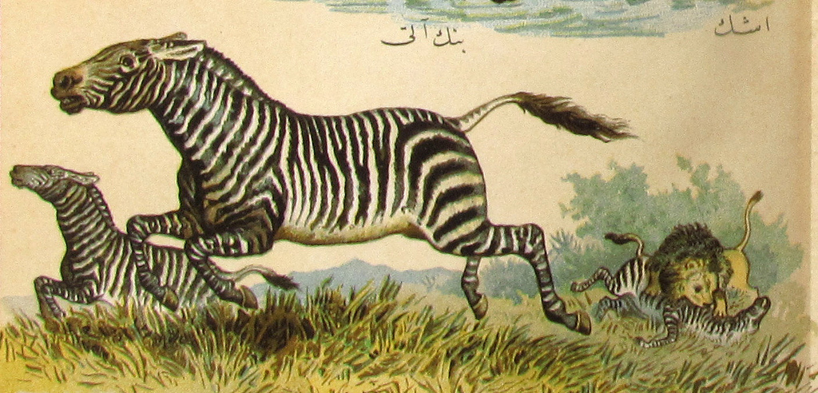

Slide 13
“The White Man’s Burden”
Some people did not adhere to the idea of Social Darwinism.
10. Europeans had a responsibility to improve the lives of the colonial peoples.
Keep in mind, this idea was still steeped in racism.

Slide 14
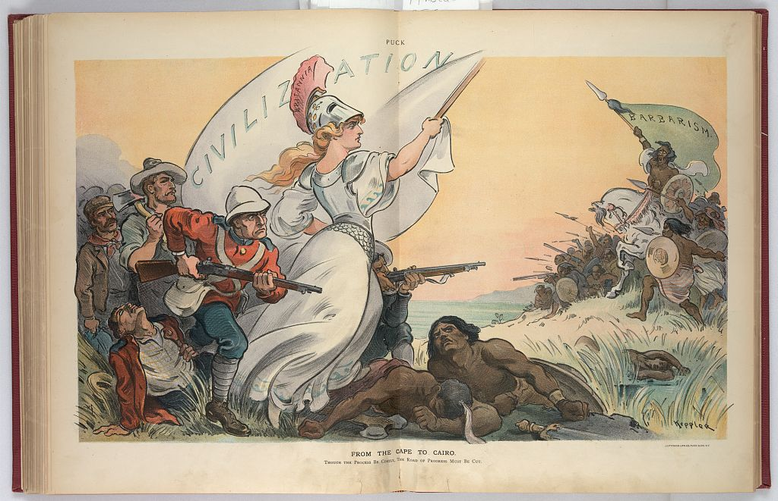

Slide 15
Singapore and Burma
These colonies provided protection from India
These colonies provided gateways into China
Growing sense of nationalism and want for power

Slide 16
Colonial Takeover in Southeast Asia
Country | Colonies | Reasons for Colonization
Great Britain | Singapore Burma (Myanmar) | These colonies provided gateways into China and protection for India.
France | Vietnam Cambodia Laos | Wanted to prevent the British from taking more territory.
Thailand | Thailand remained independent from colonial rule. | Thailand acted as a buffer between British and French territories.
The United States | Philippines | Wanted to “civilize” the Filipinos, but also was a good stopping point for trade with China.

Slide 17
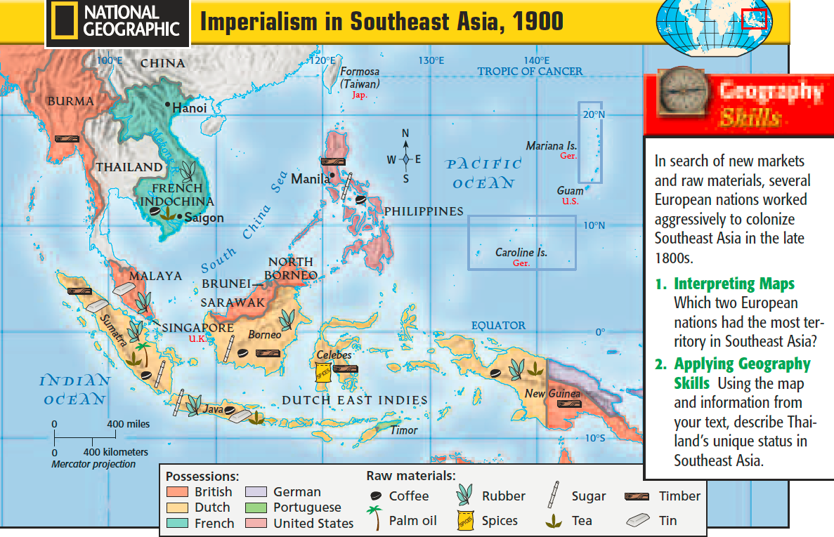

Slide 18
How did colonial powers govern their colonies?
15. Indirect Rule – local rulers are allowed to maintain their positions of authority and status.
This was cheaper and affected the locals less.
However, some local leaders resisted indirect rule. This led to direct rule.
14. Direct Rule – local officials are replaced by Western officials.

Slide 19
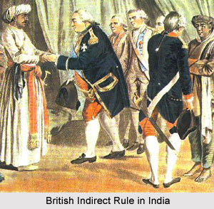

Slide 20
Colonial Economies
The colonial powers did not want their colonies to develop their own industry.
Therefore, they exported their raw materials to factories in their own countries.
This created a plantation system with low (or no) wages and bad conditions for the local people. Also the peasants had to pay high taxes.
PROFIT!!!!

Slide 21
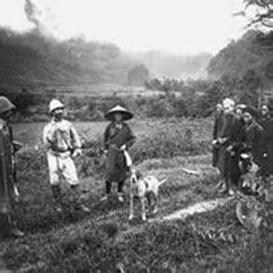

Slide 22
How did indigenous respond to colonial rule?
Obviously, many local people resented colonial rule.
At first, the ruling class and peasants often revolted but failed because of the strength of Western countries.
However, in the early 1900’s resistance based on nationalism emerged led by Westernized Intellectuals.

Slide 23
Emilio Aguinaldo
Aguinaldo was the leader for independence in the Philippines.
He first fought against the Spanish and then the Americans in the Philippine-American war.
However, he was defeated by President McKinley and the Philippines were taken by America.

Slide 24
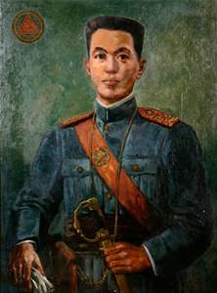
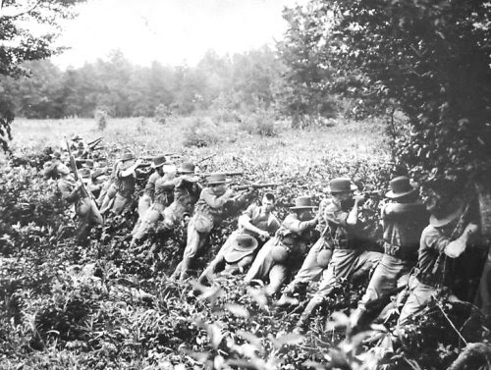
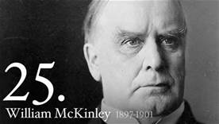

Slide 25
Lesson 2 --- The Scramble for Africa
Why were Europeans countries interested in Africa?

Slide 26
Beginnings
For hundreds of years, Africa had been the hub of the slave trade.
However, with the end of slavery in most countries, European countries began to want other resources from Africa.
In 1874, European nations began (1) annexing (adding) African nations into their empires.

Slide 27
16. African nations had no input into who ruled over their country
17. Territorial claims of colonial rulers
18. European countries & Africa

Slide 29
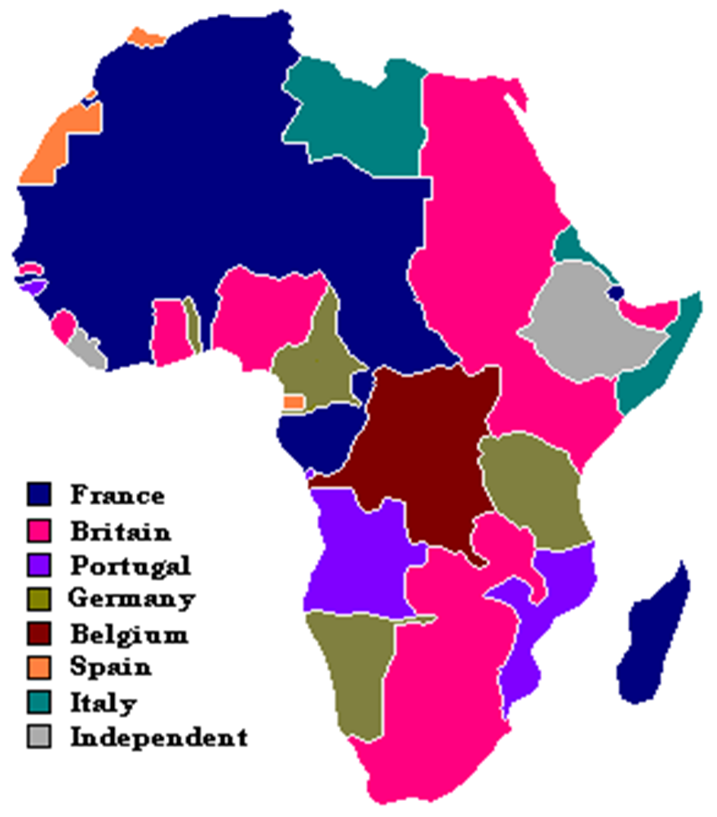

Slide 30
Egypt and the Suez Canal
In 1854, a French entrepreneur began building the Suez Canal.
European countries wanted to connect the Mediterranean Sea with the Red Sea in order to keep from having to go around Africa to get to Asia.
This was especially important for the British, so that they could get to India easier.
19. Britain to India

Slide 31
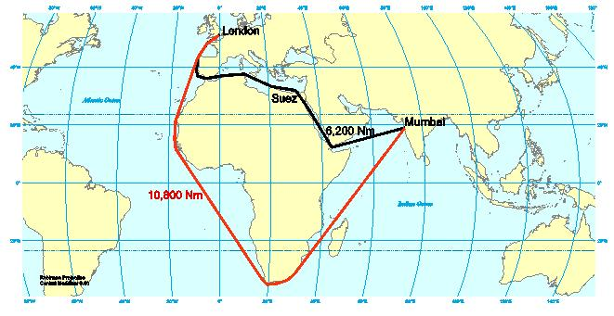

Slide 32
Ethiopia’s Resistance
Also in Northern Africa, the Italians were trying to build their empire.
They attempted to take over (15) Ethiopia but were defeated by King Menelik II.

Slide 33
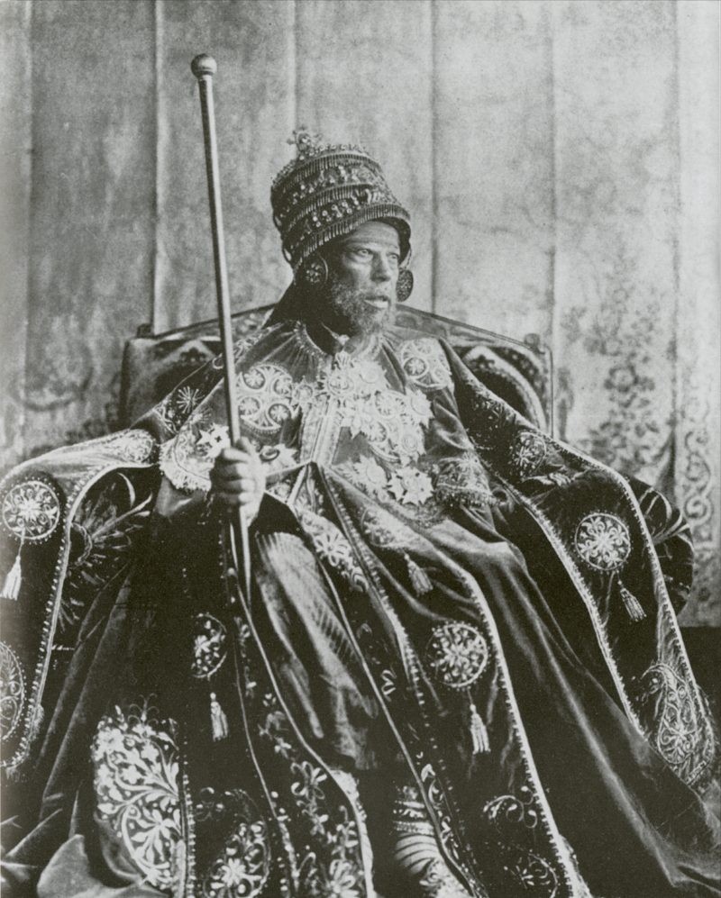
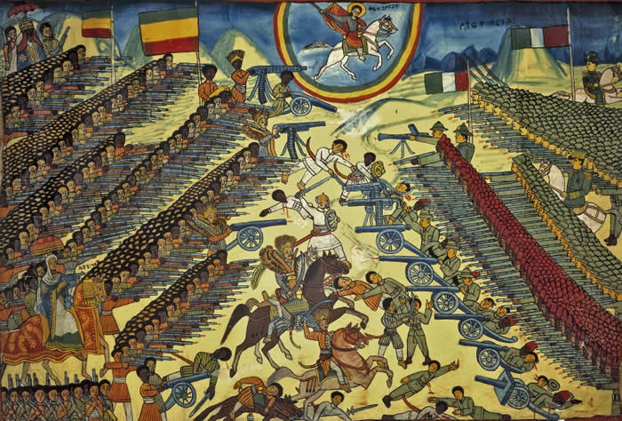

Slide 34
David Livingstone
David Livingstone was a medical missionary who wanted to find a river people could navigate that would open up Central Africa to Europeans.
However, he died and was replaced by Henry Stanley who soon discovered the Congo River Basin.

Slide 35
King Leopold
After the British refused to send settlers to the Congo, King Leopold II jumped on the opportunity to begin building his empire.
He hired Henry Stanley to set up Belgian settlements in the Congo.
This increased the race for colonies in Africa.
21. Congo
22. Belgium

Slide 36
Berlin Conference
As more countries became involved in Africa, tensions between countries began to rise.
In 1884 and 1885 European countries met in Berlin to agree upon the dividing up of African nations. NO AFRICA NATIONS WERE INVITED!
23. African & European

Slide 37
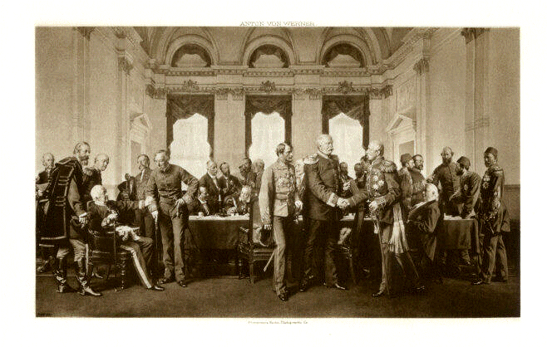

Slide 38
South Africa
Colonization in South Africa was different because of the presence of the Boers (descendants of the original Dutch settlers).
24. Dutch & British
The British took South Africa from the Boers during the Napoleonic Wars and forced them to move North.
However, the Zulu tribe fought the Boers and British to prevent them from colonizing further.
25. Indigenous & South Africa

Slide 39
Cecil Rhodes and the Boer War
Cecil Rhodes, a British businessman in the Gold and Diamond industry, raided the territories of the Boers.
26. British Businessman & Diamonds
The raid failed, however, this resulted in the Boer War. The British won and took control of South Africa and the Boer Republics.
27. Gold and Diamonds
28. Boers & Britain

Slide 40
Sepoys
Since the 1700’s, Great Britain had been establishing rule over India.
They used British soldiers and sepoys (Indian soldiers hired by the British) to protect their interests in the region.
29. Indian & British

Slide 41
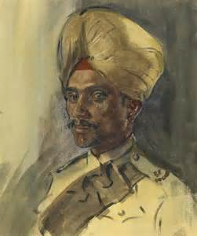

Slide 42
Cause
Growing distrust of the British
30. Load their guns with bullets greased with cow and pig fat.
Result
British imprison sepoys who refuse to load their rifles
The sepoys rebel and kill 50 European men, women, and children
Outcome
Rebellion is crushed because Indian Hindus and Muslims cannot work together.
31. British established direct rule in India.

Slide 43
Indian National Congress
The INC was made up of mostly upper-class and English-educated Indians.
Their goal was to 32. share rule with the British.
However, the religious differences between the 33. Hindus and 33. Muslims caused difficulties.

Slide 44
Cause
The Spanish treated the Cuban people badly.
Result
The United States declares war on Spain in 1898.
Outcome
The United States gains more control over Latin America including Cuba and Puerto Rico
The United States wanted more power in the region (Monroe Doctrine).
34. Spain being kicked out of Latin America.

Slide 45
Panama Canal
In 1903, President Theodore Roosevelt supported a rebellion in Panama to overthrow Columbian rule.
The Panama Canal was built to connect the 35. Atlantic and the Pacific Ocean.
The project was directed by U.S. president Theodore Roosevelt.

Slide 46
The Roosevelt Corollary
Roosevelt’s next step in gaining power was adding to the Monroe Doctrine.
In the Roosevelt corollary to the Monroe Doctrine, Roosevelt claimed that the US could intervene in any Latin American country that was guilty of misconduct.
36.America & Latin American countries

Slide 47
Dollar Diplomacy
In the early 1900’s, America began to pursue the policy of 37.dollar diplomacy.
Dollar diplomacy was when the United States extended its influence by investing money in 37.Latin America countries.
As a result, America sent troops to these countries to protect their interests. This made many of these countries resent the U.S.

Slide 48
Revolution in Mexico
38.Porfirio Diaz – was the conservative dictator of Mexico between 1877 and 1911. The rich Mexicans loved him but the poor despised him.
Francisco Madero – was a liberal politician who forced Diaz out of power.
Pancho Villa - a bandit who supported Mexican workers and took advantage of the political chaos in Mexico.
Emiliano Zapata – a revolutionary who wanted to redistribute the land to the poor and needy.
39. fought for the rights of the poor

Slide 49
Who were the Boers in South Africa?
A native tribe that fought the British in South Africa
British soldiers who protected British national interest in South Africa
Dutch settlers who fought against British rule in South Africa
Indigenous people who fought with the British against the Zulu tribe

Slide 50
