Slide 1
Section 2: Roots of the Revolution

Slide 2
Ready for the Revolution
The political crisis of 1789 coincided with the worst famine in recent history.
The “Great Fear,” as it became known, was sparked by rumors that troops were attacking villages and burning crops.
It led to peasants attacking nobles.

Slide 3
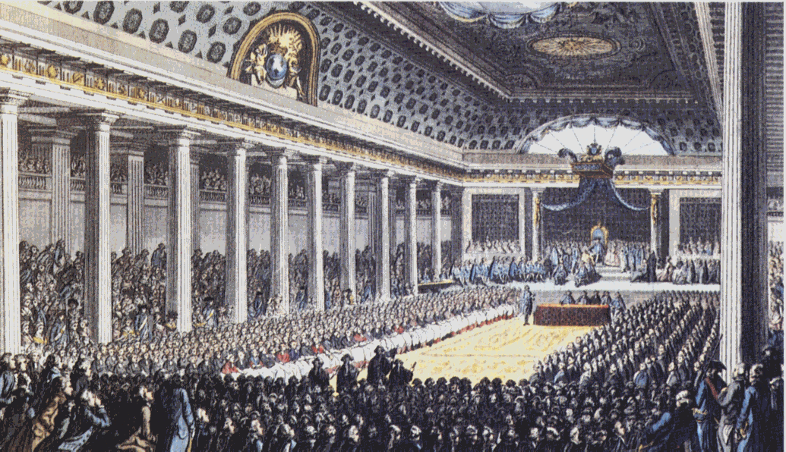
Louis XVI Calls the Estates-General
Louis XVI Calls the Estates-General
As 1788 came to a close, France teetered on the verge of bankruptcy
Bread riots were spreading, and nobles, fearful of taxes, were criticizing royal tyranny
The wealthy and powerful classes (nobles) demanded that the king summon the Estates-General before making any changes.
Estates-General: the legislative body consisting of representatives of the three estates.

Slide 4
Louis XVI Calls the Estates-General
Delegates Take the Tennis Court Oath
Delegates to the Estates-General from the Third Estate were elected, though only propertied men could vote
Thus, the delegates were mostly lawyers, middle-class officials, and writers
They were familiar with the writings of Voltaire, Rousseau, and other philosophes
They went to Versailles not only to solve the financial crisis but also to insist on reform

Slide 5
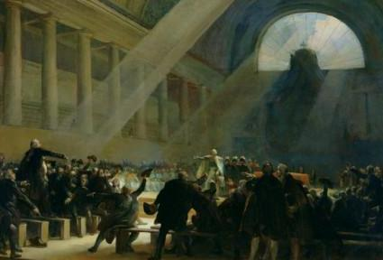
Louis XVI Calls the Estates-General
After weeks of stalemate, delegates of the Third Estate took a daring step
Claiming to represent the people of France, they declared themselves to be the National Assembly in June 1789
A few days later, the National Assembly found its meeting hall locked and guarded
Fearing that the king planned to dismiss them, the delegates moved to a nearby indoor tennis court

Slide 6
Louis XVI Calls the Estates-General
As curious spectators looked on, the delegates took their famous Tennis Court Oath
They swore “never to separate and to meet wherever the circumstances might require until we have drafted a sound and just constitution for France”
When reform-minded clergy and nobles joined the Assembly, Louis XVI grudgingly accepted it
But royal troops gathered around Paris, and rumors spread that the king planned to dissolve the Assembly

Slide 7
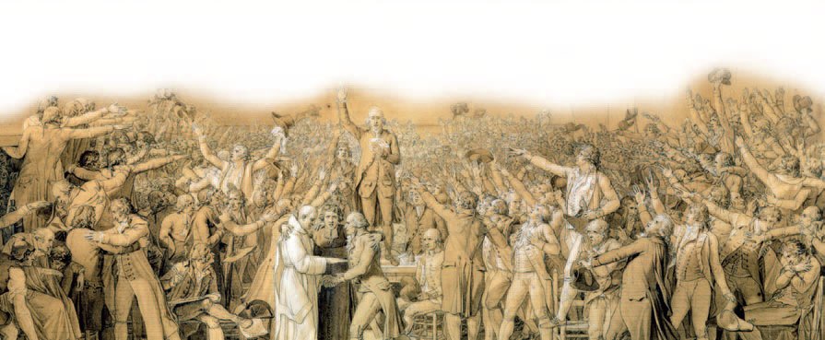
Tennis Court Oath

Slide 8
Parisians Storm the Bastille
Parisians Storm the Bastille
On July 14, 1789, the city of Paris seized the spotlight from the National Assembly meeting in Versailles
The streets buzzed with rumors that royal troops were going to occupy the capital (Great Fear Rumors)
More than 800 Parisians assembled outside the Bastille, a grim medieval fortress used as a local prison for political and other prisoners
To many French people, the Bastille represented the injustices of the monarchy
The French Citizens attacked & demanded weapons and gunpowder believed to be stored there to protect themselves.

Slide 9
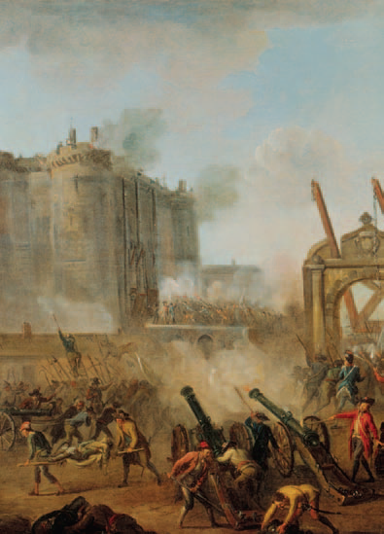
Parisians Storm the Bastille
The Bastille was a symbol to the people of France representing years of abuse by the monarchy
The storming of and subsequent fall of the Bastille was a wake-up call to Louis XVI
Unlike any other riot or short-lived protest, this event posed a challenge to the sheer existence of the regime
Since 1880, the French have celebrated Bastille Day annually as their national independence day

Slide 10
The National Assembly Acts
The National Assembly Acts
Peasant uprisings and the storming of the Bastille stampeded the National Assembly into action
Special Privilege Ends (1st moderate reform)
On August 4, in a combative all-night meeting, nobles in the National Assembly voted to end their own privileges
They agreed to give up their old manorial dues, exclusive hunting rights, special legal status, and exemption from taxes

Slide 11
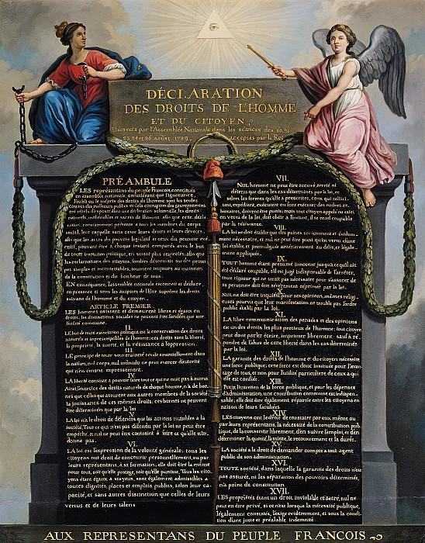
The National Assembly Acts
Equality of all men before the law (2nd Moderate reform)
Declaration of the Rights of Man
In late August, as a first step toward writing a constitution, the Assembly issued the Declaration of the Rights of Man and the Citizen

Slide 12
The National Assembly Acts
The document was modeled in part on the American Declaration of Independence, written 13 years earlier
All men, the French declaration announced, were “born and remain free and equal in rights”
“Men are born, and always continue free and equal in respect of their rights. Civil distinctions, therefore, can be founded only on public unity
Slogan of the French Revolution
“Liberty, Equality, Fraternity”

Slide 13
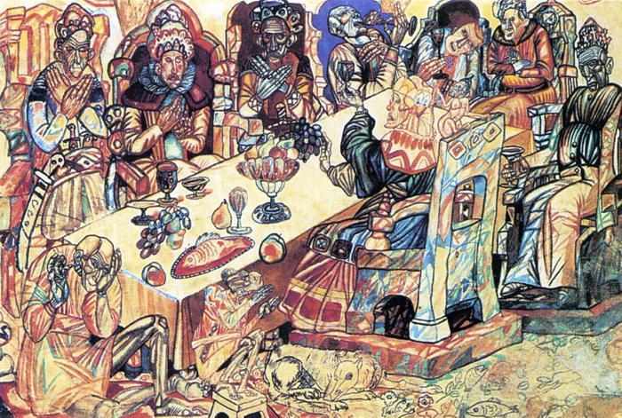
The National Assembly Acts
The Declaration of the Rights of Man met resistance
Uncertain and hesitant, Louis XVI did not want to accept the reforms of the National Assembly
Nobles continued to enjoy gala banquets while people were starving
By autumn, anger again turned to action

Slide 14
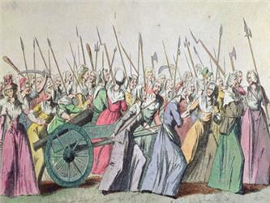
The National Assembly Acts
Women March on Versailles
On October 5, about six thousand women marched 13 miles in the pouring rain from Paris to Versailles
“Bread!” they shouted
They demanded to see the king
Much of the crowd’s anger was directed at Marie Antoinette

Slide 15
The National Assembly Acts
The women refused to leave Versailles until the king returned to Paris and addressed the famine issues of the people.
Not too happily, the king agreed
The next morning, the crowd, with the king and his family in tow, set out for the city
At the head of the procession rode women perched on the barrels of seized cannons
They told bewildered spectators that they were bringing Louis XVI, Marie Antoinette, and their son back to Paris

Slide 16
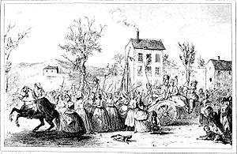
The National Assembly Acts
Crowds along the way cheered the king, who now wore the tricolor
In Paris, the royal family moved into the Tuileries (TWEE luh reez) palace
For the next three years, Louis was a virtual prisoner

Slide 17
French Government Changes
By the end of 1791, Radicals had gained control of the French Government.
Radicals: people with far-reaching ideas and changes.
War with neighboring countries soon erupted, adding the threat of foreign invasion.
This threat lead to the French Revolution becoming more radical.

