Slide 1
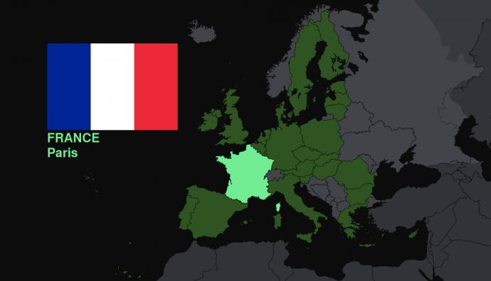
The French Revolution
Chapter 8

Slide 2
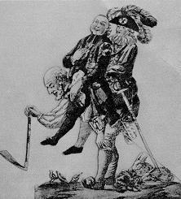
French Society Divided
French Society Divided
In 1789, France, like the rest of Europe, still clung to an outdated social system that had emerged in the Middle Ages
Under this ancient régime, or old order, everyone in France was divided into one of three estates, or social classes.
The estate system dated back many centuries in France.

Slide 3
French Society Divided
The estates determined a person’s legal rights and status
The First Estate was made up of the clergy- catholic church leaders (0.5%)
The Second Estate was made up of the nobility- military & government leaders, large landowners (1.5%)
The Third Estate comprised the vast majority of the population (98%)
Bourgeoisie (Middle Class)- Doctors, Lawyers, Merchants
Artisans-Urban Workers
Peasants

Slide 4
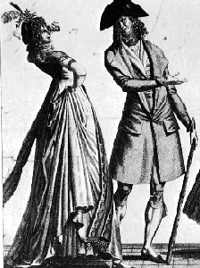
French Society Divided
Middle Class and Peasants – 3rd Estate
At the top sat the bourgeoisie (boor zhwah ZEE), or middle class
The bourgeoisie included prosperous bankers, merchants, and manufacturers, as well as lawyers, doctors, journalists, and professors

Slide 5
There was great discontent in the Third Estate for many reasons:
Resented other estates’ privileges
Wealthy could buy their power & titles
Small increases in prices brought starvation to many
Paid all the taxes

Slide 6
While social inequalities were driving poor people toward revolt, new ideas from the Enlightenment were also inspiring the French Revolution. Many educated members of the bourgeoisie knew about the writings of the great Enlightenment philosophers John Locke, Baron de Montesquieu, and Jean Jacques Rousseau.
More recently, they had learned that American colonists, inspired by Enlightenment ideas, had successfully rebelled against Britain’s king. (American Revolution)
Seeing how these ideas were transforming government and society in other countries, some of the bourgeoisie began to consider how these ideas might be used in France.

Slide 7
Financial Troubles
Main causes of France’s Financial Problems
1. Massive Debt of the French Government
Louis XIV had left France deeply in debt
The Seven Years’ War and the American Revolution strained the treasury even further
Costs generally had risen in the 1700s, and the lavish court soaked up millions
To bridge the gap between income and expenses, the government borrowed more and more money
By 1789, half of the government’s income from taxes went to paying the interest on this enormous debt

Slide 8
Financial Troubles
2. Soaring Food Prices
Also, in the late 1780s, bad harvests sent food prices soaring and brought hunger to poorer peasants and city dwellers
To solve the financial crisis, the government would have to increase taxes, reduce expenses, or both
However, the nobles and clergy fiercely resisted any attempt to end their exemption from taxes

Slide 9
Financial Troubles
3. King Louis XVI’s failure to propose reforms
King Louis XVI continued lavish spending & refused to tax the 1st & 2nd Estates
Deficit spending occurs whenever a government's expenses exceed its income over a fiscal period (year).
Leads to the creation or enlargement of a governments debt

Slide 10
Ready for the Revolution
The political crisis of 1789 coincided with the worst famine in recent history.
The “Great Fear,” as it became known, was sparked by rumors that troops were attacking villages and burning crops.
It led to peasants attacking nobles.

Slide 11
Letter to Louis
Using what you have learned from class, write a letter to Louis XVI persuading him to take a certain action before the country turns to revolution. You may write your letter from the perspective of the role you played in class, or you may choose to be from someone of another class/estate. Be sure to include what specific actions Louis should take, as well as how you believe this will benefit the country as a whole and keep them from turning to revolution. Don’t forget to sign it, too!

